Slide 1
TRL5+ Wind Tunnels Subgroup
NWTF 2023 Conference
Raul Vazquez – Fellow in Aerodynamics and Chief of Aerothermal Technology at Rolls-Royce
26th May 2023
Statement
The information in this document is proprietary and confidential to Rolls‑Royce and is available to authorised recipients only – copying and onward distribution is prohibited other than for the purpose for which it was made available.

Slide 2
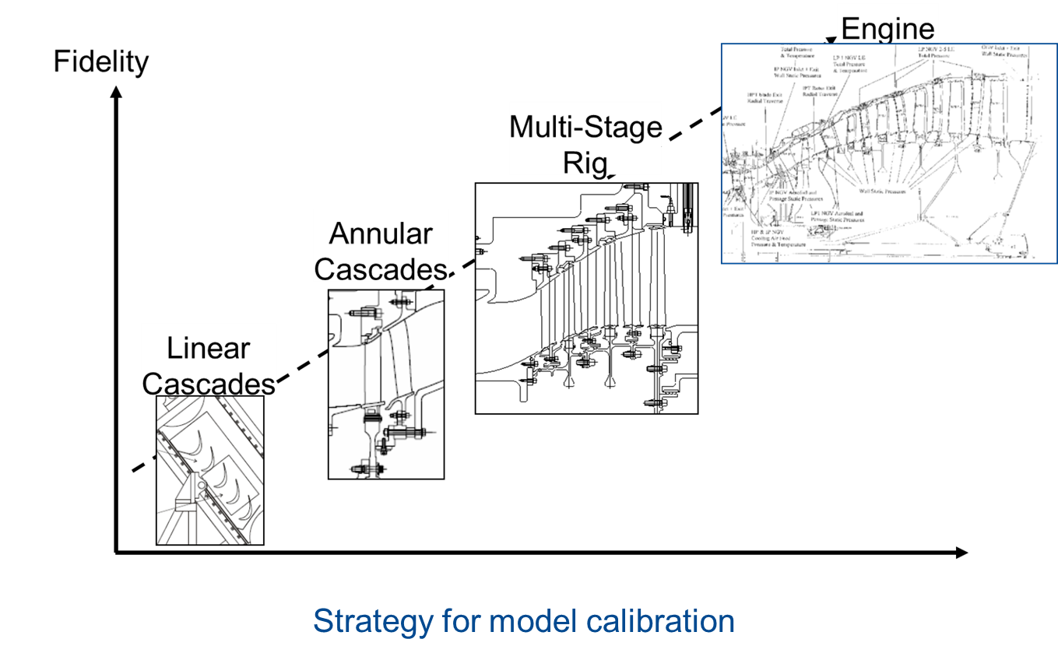
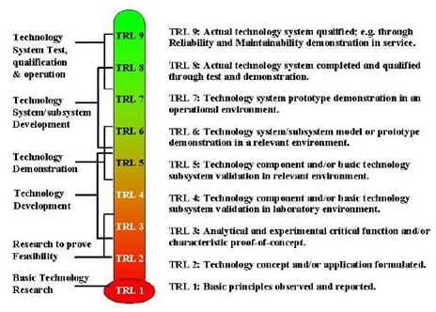
Example for Axial Turbines
Validation Process for Gas Turbines Aero Technologies
TRL 7-9
TRL6
TRL5
TRL4
Time

Slide 3
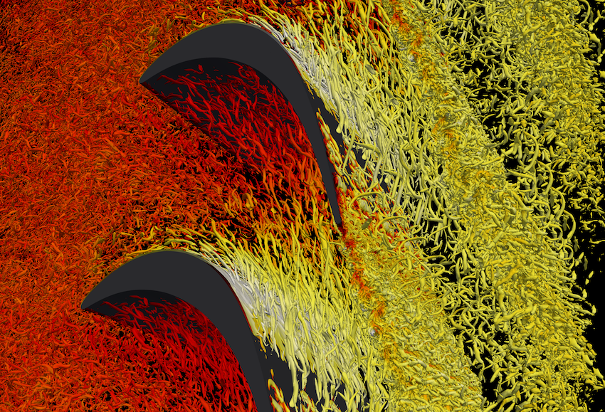
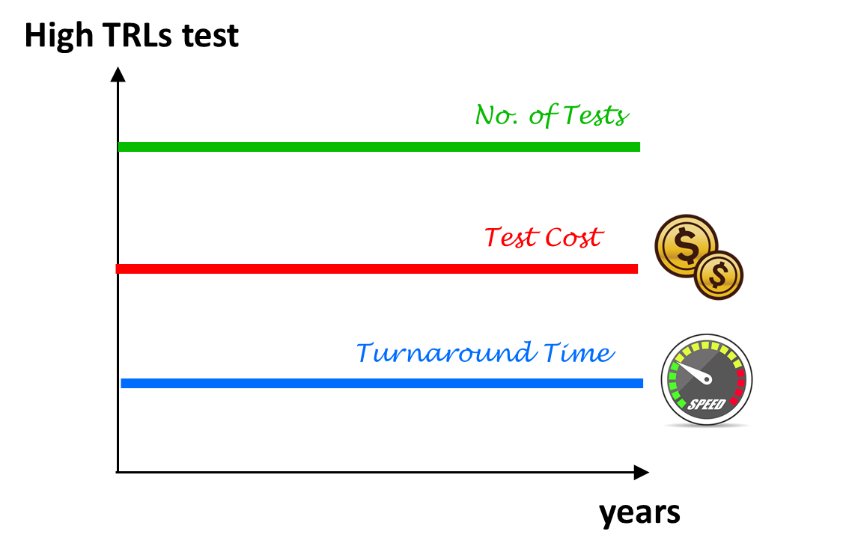
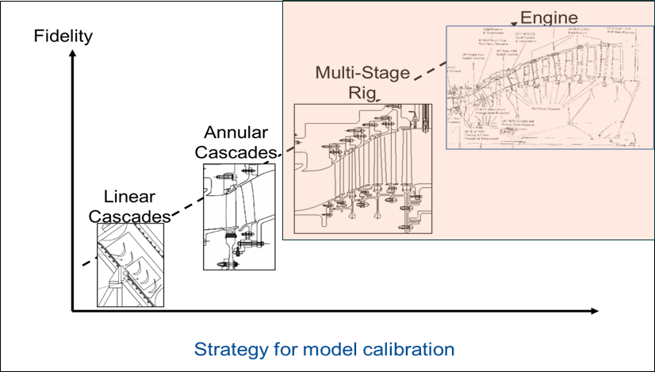
Time-Evolution of Technology Validation Process
Scale Resolving simulations up to Re ∼ O(10⁵)

Slide 4
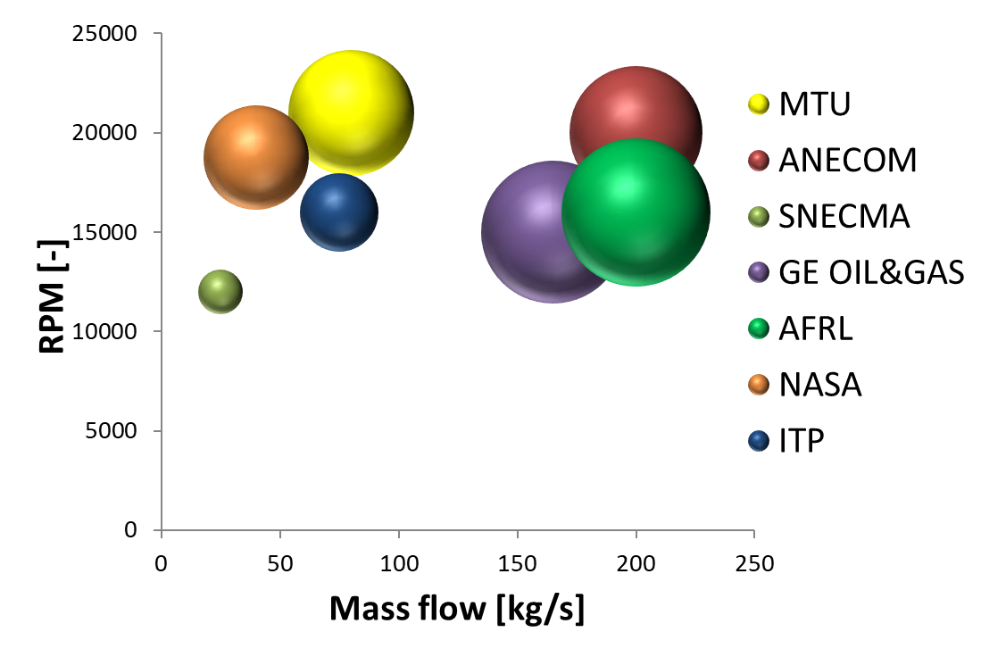
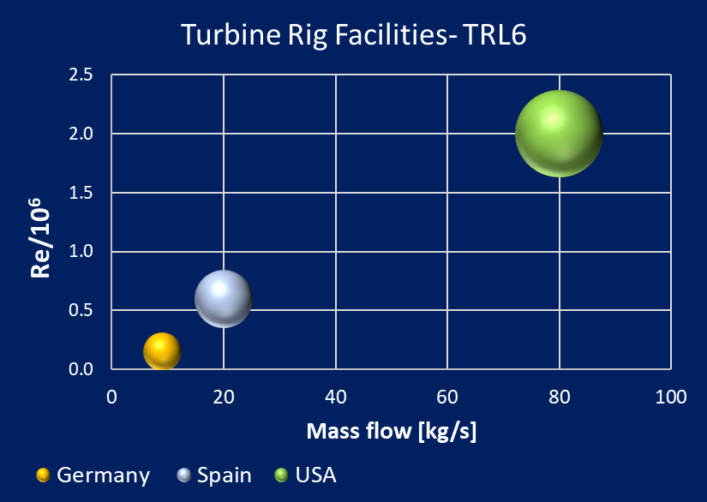
Location of TRL6 Experimental Facilities
TRL6 Facilities for Axial Compressors
TRL6 Facilities for Axial Turbines
Notes:
Let us talk now about the model uncertainties. First, due to numerics. In order to reduce these uncertainties, we are using high order spectral/hp element methods (as shown in this slide). This approach possesses the desirable numerical properties combining the geometric flexibility of finite volume methods with the advantageous phase and diffusion properties of spectral methods. The local mesh spacing ℎ needs to be selected at a scale comparable to that of the flow features, on top of which p refinement at fixed ℎ allows for exponential convergence. As you can see in the video, the top left is the exact solution, the top right is the classical second order solution and at the bottom you can see how the solution improves when p is increased and even when a coarser mesh.

Slide 5
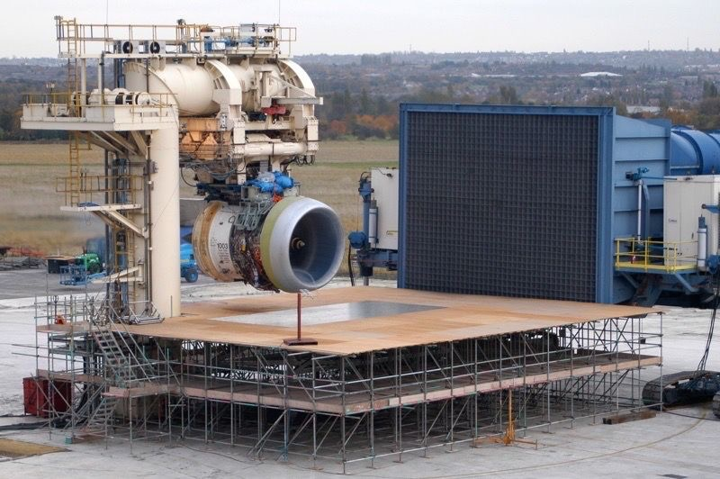
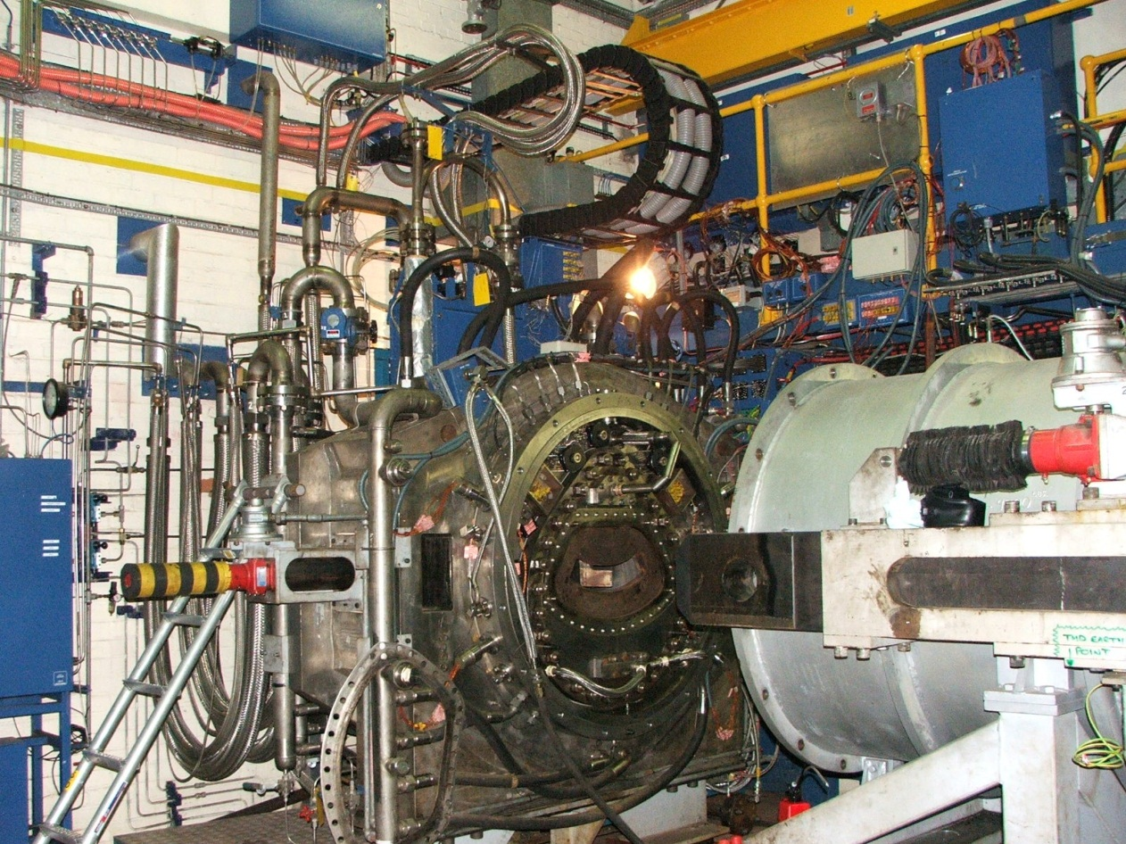
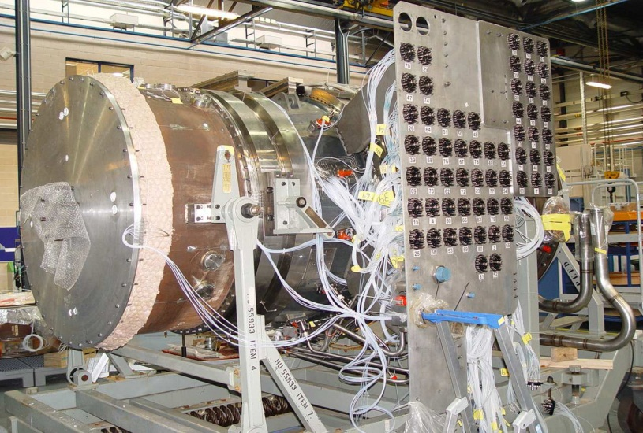
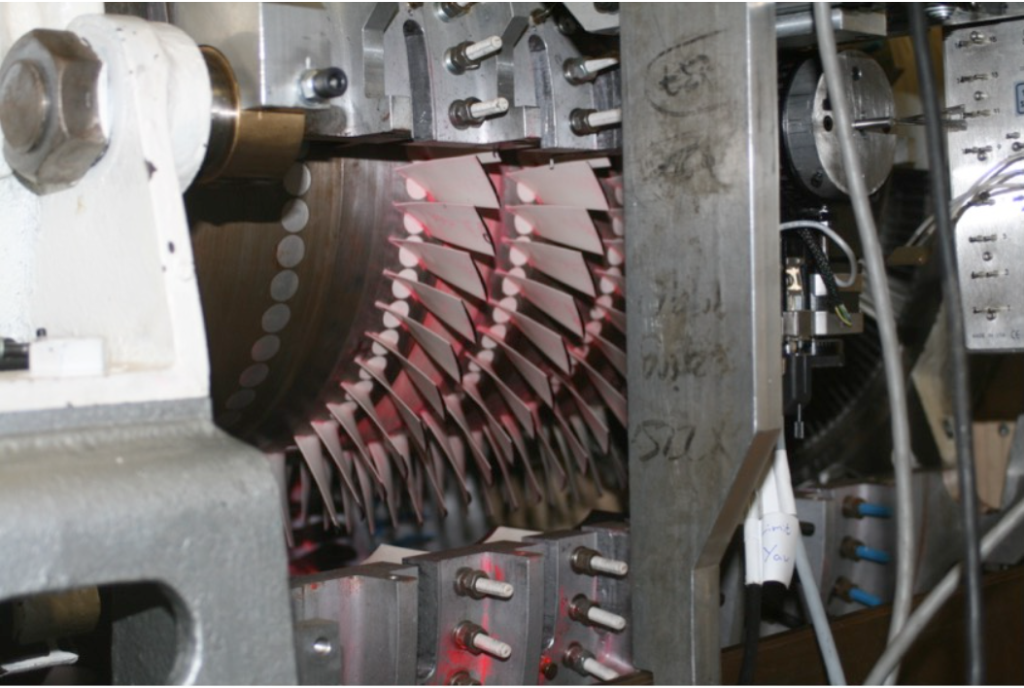
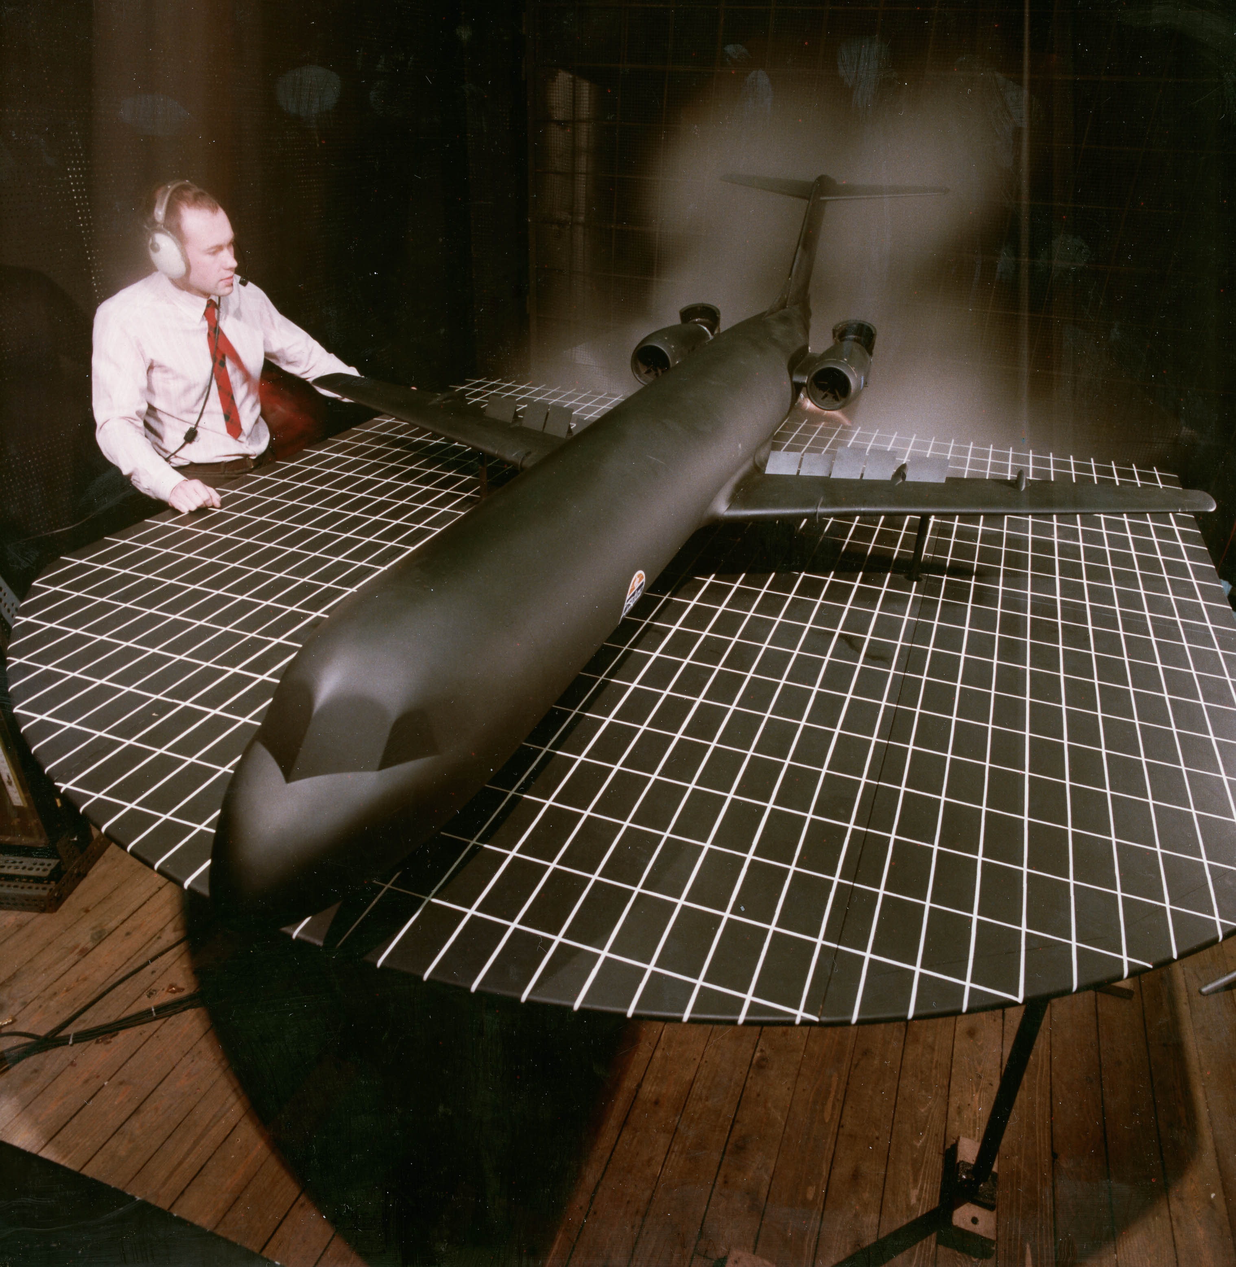
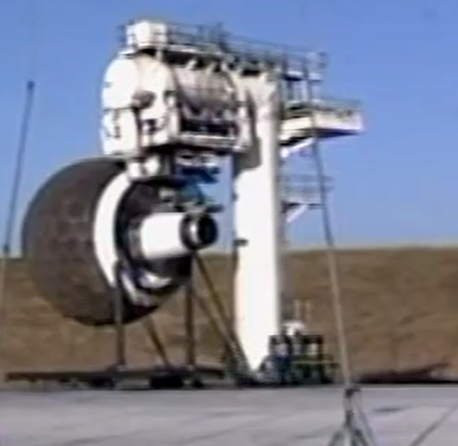
Landscape 20-30 Years Ago
New image to follow
Large Engine outdoor 9 Test Bed at the Rolls-Royce Hucknall facility from 1970’s to the early 2000’s
High Pressure Full Annulus Combustor facility at Rolls-Royce Derby A-site early 2000’s
ANTLE Turbine Rig. Last turbine tested at Rolls-Royce Two Shaft ATF turbine facility at Derby Main Works 2004
CTR6 High Pressure Axial Compressor Rig facility at Rolls-Royce Main works 1990’s
Model F100 in the wind tunnel at Rolls-Royce Hucknall facility
Large Engine outdoor 11 Test Bed at the Rolls-Royce Hucknall facility from 1970’s to the early 2000’s
https://web.yammer.com/main/threads/eyJfdHlwZSI6IlRocmVhZCIsImlkIjoiMTY3NDg1MDkyNDgzODkxMiJ9
Notes:
The Advance2 engine core of the Pearl 700 and the Pearl 10X has been tested on 100% Sustainable Aviation Fuel.
Derby Innovation Lab

Slide 6
Technology Validation Gap
Today Challenge
After Brexit, access to European facilities /financial support as well as Technology exchange is more challenging for UK industry.
Need of National Financial Support for Tech Validation (TRL5+) abroad.
Need of National Infrastructure (TRL5+) for Tech validation
Notes:
As said, this approach is very time effective, however it has an inconvenient for the industry, it requires people with expertise and understating of the physics and design of gas turbines and it is perceived like very complex from non-experts. Many people ask me, why do we need all these complex low, medium fidelity models, why do we still need correlations? Why can we not run a hi-fi CFD from CAD geometry and define of the parameters by a DOE optimisation? And even more why this process can’t be automatic and hence we can save many hours of engineers? If we make a quick estimation of how much longer would be to do with the existing computers, as you can see there we would need 1000 times more time, we would need decades or centuries for one single design. Of course, this can improve the future but today this is the answer. What are we doing to improve the speed? As you can see in the slide, we are Fully Integrated and automatic design systems (Davinci), Most effective and accurate Low & Medium Fidelity Models, Exploiting emerging hardware capabilities, e.g. GPUs, Nonlinear harmonic method (Ning and He, 1998), Space-time gradient method (Yi and He, 2015), etc.

Slide 7
Current Landscape
Sustainable aviation is an essential step towards Net Zero by 2050.
Sustainable Aviation will require disruptive technologies.
Due to the high complexity and high safety standard demands, disruptive technology in aviation entails very long turnaround, usually few decades.
Therefore, a solution is needed sooner and hence, the technology development process for aviation must be substantially shortened.
Combination of simulations with high TRL tests are probably the only way to reduce the process.
To be ready for the climate challenge then, world-class CFD and Computing capabilities together with a word-class TRL5+ Wind Tunnel infrastructure are of vital importance for UK.
Today, the UK TRL5+ Wind Tunnel infrastructure presents significant gaps and financial challenges due to the existing business model.
After Brexit, access to European facilities /financial support as well as Technology exchange is more challenging for UK industry.
Timescales are tight – it takes many years to establish high TRL facilities.
TRL 5+ Wind Tunnels – UK strategy - next steps

Slide 8
Proposal
A list of existing strategic national TRL5+ facilities should be agreed.
The business model for those strategic facilities should be revised and new model should be established to provide financial sustainability and maintain word-class capabilities.
A gap analysis is required to identify the strategic gaps in TRL5+ facilities.
Non-UK facilities that could fill these gaps should be identified among the UK research community.
A national agreement with the institutions that own those facilities should be established. This agreement should guarantee UK requirements and priorities.
National Financial support for tests in those institutions should be provided through the existing financial mechanisms.
When 5 was not possible, new facilities should be built in the UK to fill those gaps.
TRL 5+ Wind Tunnels – UK strategy - next steps

Slide 11
General
How do we drive collaboration and coordination while spreading risks, in particular across TRLs or between the academic-led fundamental/experimental research and industrial applied research/technology development?
How do we maintain existing infrastructure to deliver our objectives, ideally how we maximise the use and benefits of existing facilities?
How we do we maintain industry focused capability in what is a cyclical market?
Where are the gaps in UK 5+TRL wind tunnels?
What UK technology or products cannot be developed without these wind tunnels?
What would be the tangible UK benefits (jobs, investment, technology/knowledge spillovers etc) of establishing any new UK TRL5+ facilities?
Who would be the users of any new facilities? What are the industry utilisation commitments and timescales?
Are suitable facilities accessible elsewhere?
In terms of access/funding for EU test facilities, what is different now vs 5 -10 years ago?
Are there case studies on overseas national research programmes funding aerodynamic testing research activity the UK?
What are the benefits/risks (or what is the counterfactual)?
TRL 5+ Wind Tunnels – UK strategy - next steps
TRL5+ ask on new facilities
TRL5+ ask on non-UK testing

Slide 12
Copy here

