Slide 1
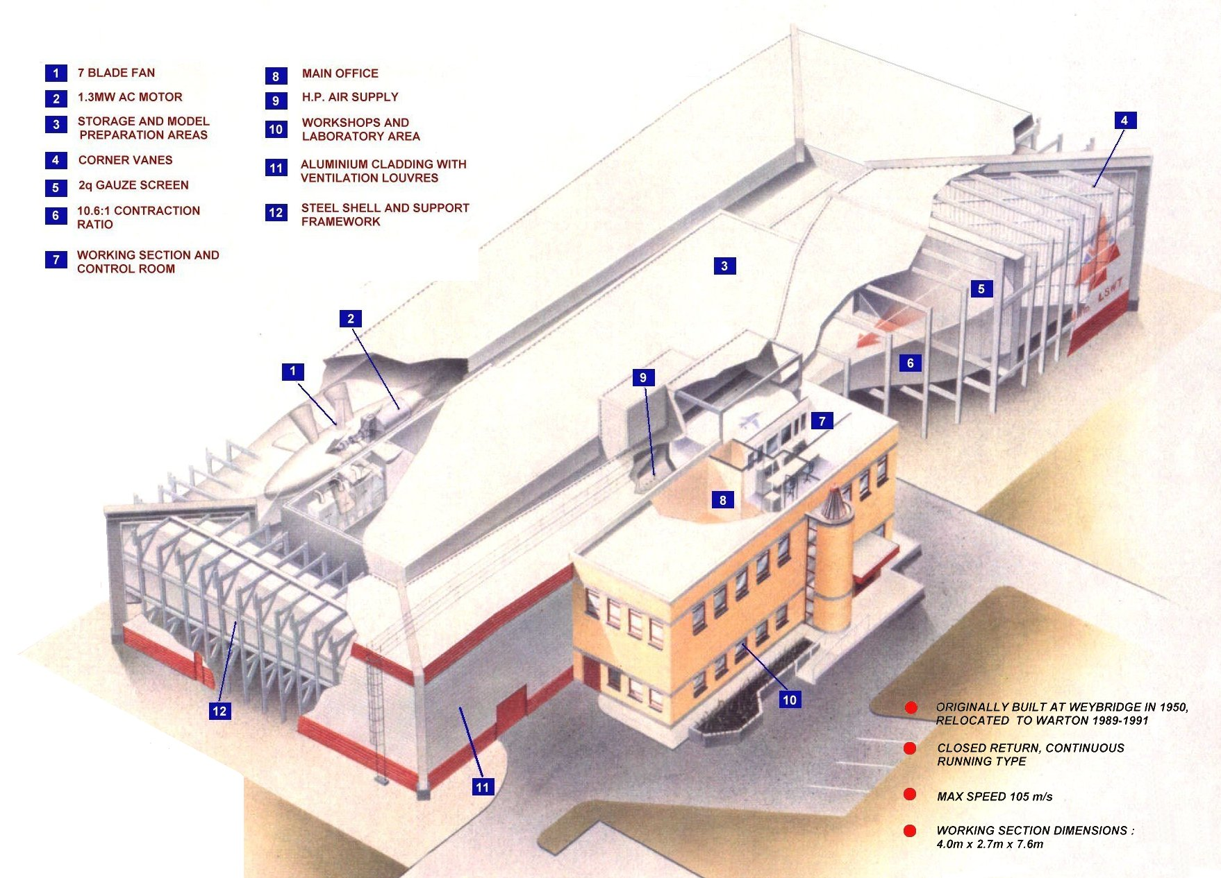
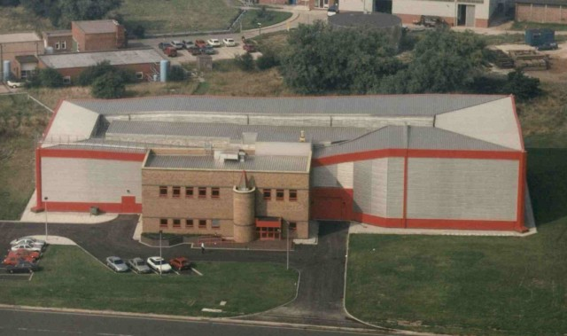
4m Wind Tunnel, Warton, Lancashire
Facility overview
Built at Weybridge in 1950 and relocated to Warton in 1989-1991
Working section size: 4.0m x 2.7m x 7.6m (13ft 1in x 8ft 10in x 24ft 11in)
Tunnel pressurisation: Ambient stagnation pressure
Maximum flow speed: M = 0.3
Operating temperature: Ambient temperature
Main drive fan: 1.3MW (1,740hp) AC motor 24ft diameter, 7 fixed pitch blades 410 rpm max
Contraction ratio of 10.6:1
Primarily used for stability and control measurements, powered models and intake tests
Notes:
Copyright © 2005 BAE Systems. All rights reserved.

Slide 2
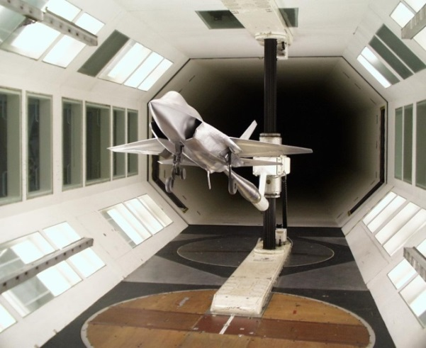
4m Wind Tunnel, Warton, Lancashire
Instrumentation
Sting or Strut Mounting Systems
2 floor mounted (1 active) and 1 roof mounted turntables
6-component balance:
Aerotech weigh beam balance (under floor)
Strain gauges and load cells
Calibration rig & hardware
Model Pressure Measuring Systems
digital multi-pressure measurement systems (Scanivalve MPS, Chell nanoDAQ)
Pressure Transducers (Druck, Kulite, Endevco)
Flow visualisation: smoke, tufting and oil flows
Common expandable DAS with flexible data visualisation systems
Ground effect testing
PIV
Engine face rake measurements (6” Static + Swirl / Dynamic)
Notes:
Copyright © 2005 BAE Systems. All rights reserved.

Slide 3
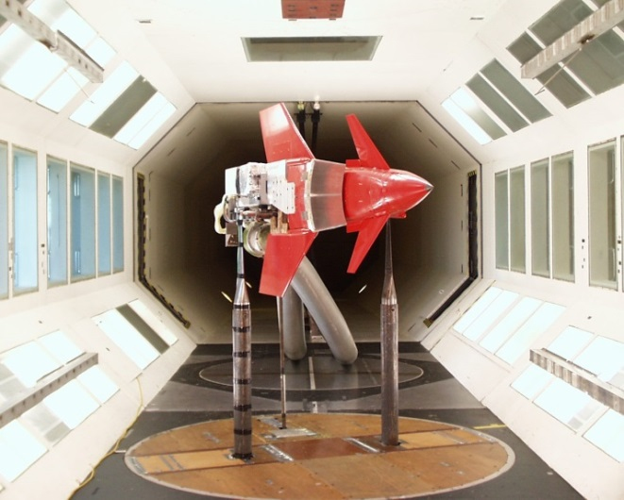
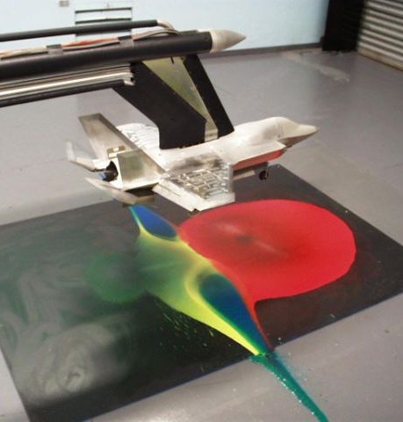
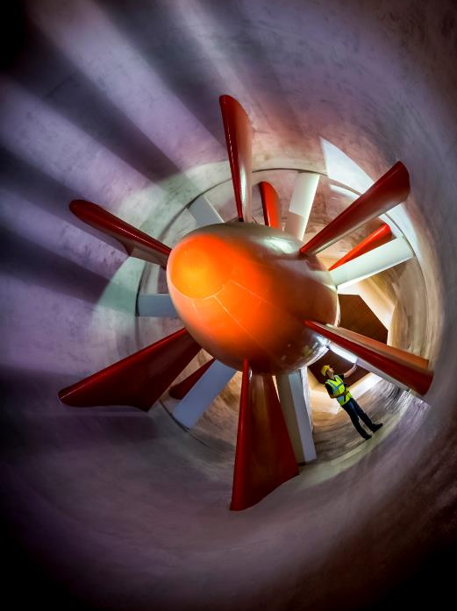
4m Wind Tunnel, Warton, Lancashire
Tunnel operations
Test team consisting of engineers experienced in aerodynamics, instrumentation, design, manufacture, computing, mechanical and electrical
Flexible working arrangements around 37hrs. Normal tunnel operation between 07:00 – 18:30 (20:20 on shift working)
Pluses / minuses
Successful repair of CFC blades to allow running to recommence following a 7 month activity
Active recruitment of junior engineers
Condition Monitoring of Fan Blades (blade deflection, Vibration sensors)
Aging facilities requiring more maintenance and repair work to operate
Loss of key experienced personnel and use of legacy in-house developed software
Rolling Rig capability lost when the 5.5mLSWT closed in 2010
Notes:
Copyright © 2005 BAE Systems. All rights reserved.

