Slide 1
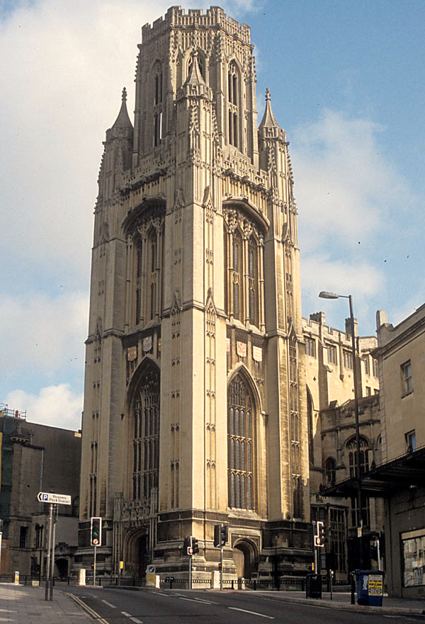
Wind Tunnel Facilities at the University of Bristol

Slide 2
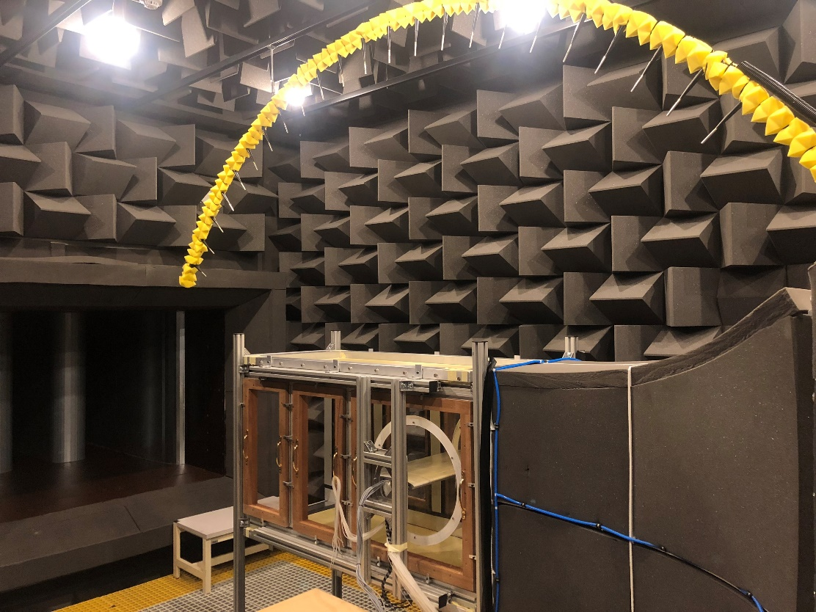
National Aeroacoustics Wind Tunnel
A unique facility nationally, consisting of a very quiet closed-circuit wind tunnel and a large anechoic chamber.
Powered by a 75kW centrifugal fan and is equipped with a series of large silencers.
The wind tunnel is equipped with a 40kW water cooled chiller, enabling continuous testing at a set temperature, between 15º to 30º.

Slide 3
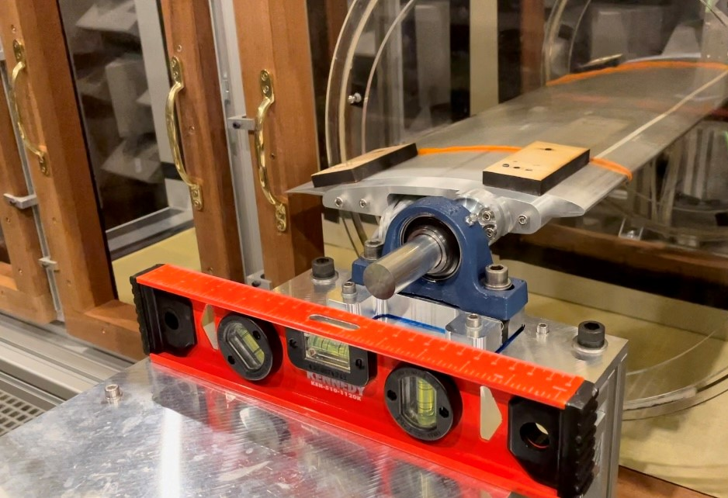
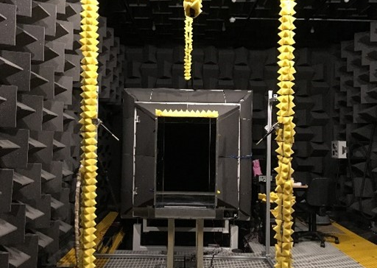
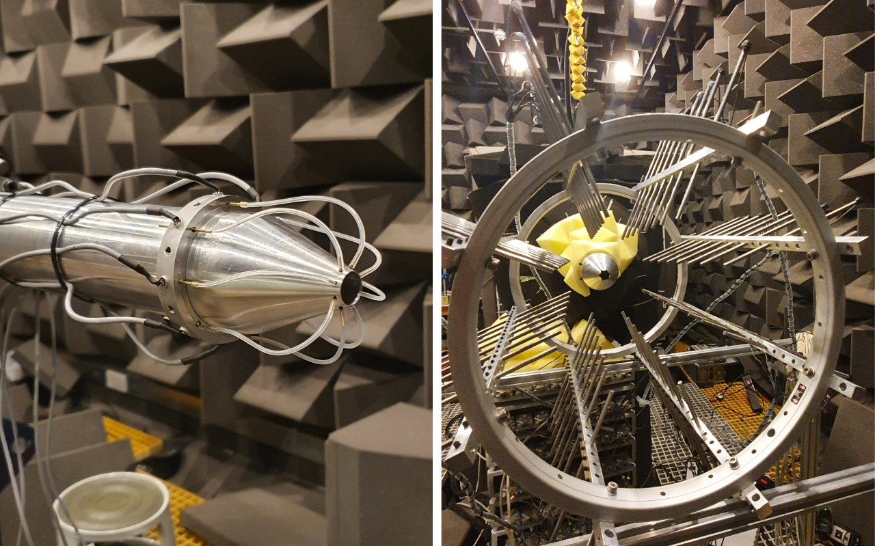
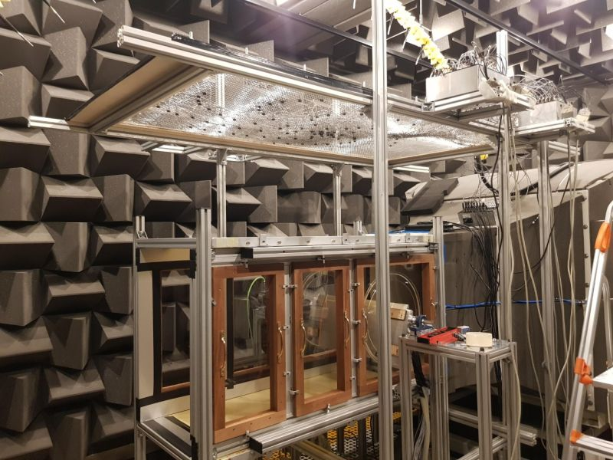
Research Areas
Aerodynamic performance and noise measurements of:
Aerofoils
Bluff-bodies (landing gears)
Subsonic/supersonic jets
Electric propulsions

Slide 4
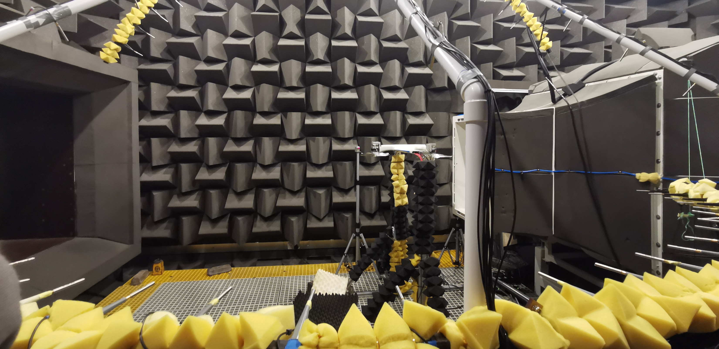
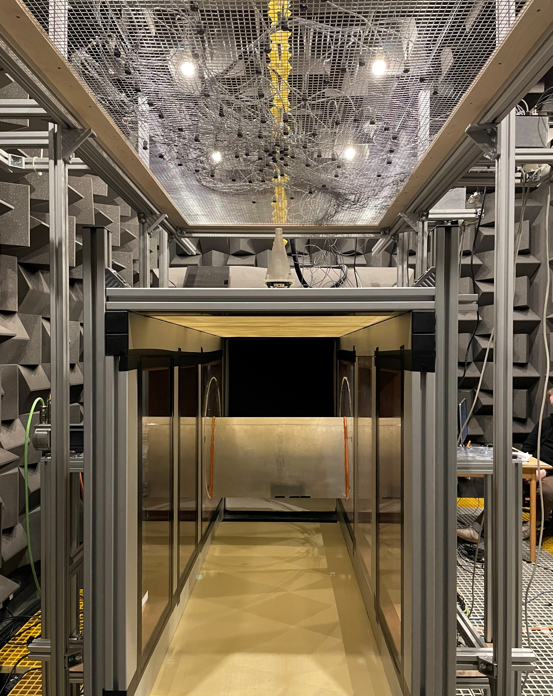
Acoustic measurement: far-field arcs and large elliptic reconfigurable beamforming array
Near-field pressure measurement: in-situ static and dynamic pressure sensing
Velocity fields: hot-wire anemometry; particle image velocimetry

Slide 5
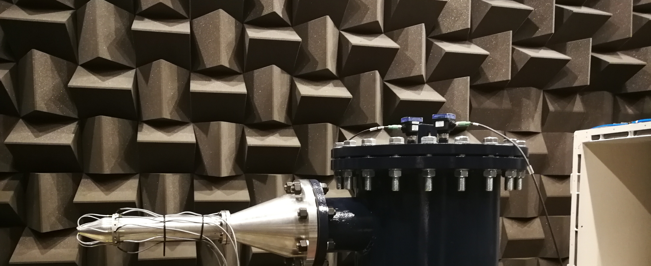
High-speed Jet Facility
The high-speed jet facility is an ideal infrastructure for jet aerodynamics, jet noise, jet installation effects.
The air supplied by three separate compressors, enabling a jet flow at Mach numbers in the range between 0.1 and 1.4.
A range of nozzles with different diameters (1cm to 5cm) and different lip geometries

Slide 6
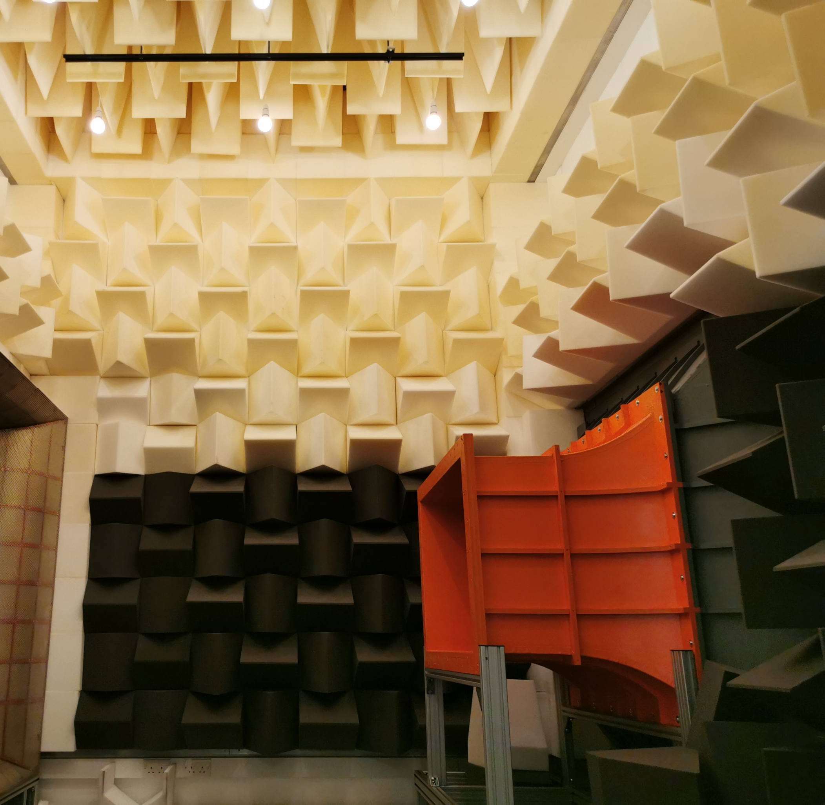
Pressure-neutral Wind Tunnel
The pressure-neutral acoustic wind tunnel is closed-loop, open section. The facility has recently undergone a series of major upgrades:
Free-stream velocity range 5m/s to 30m/s
A rectangular nozzle part with a cross-section measuring 1.0m in width by 0.7m in height
Two sets of large splitter silencers to significantly reduce flow noise in the tunnel

Slide 7
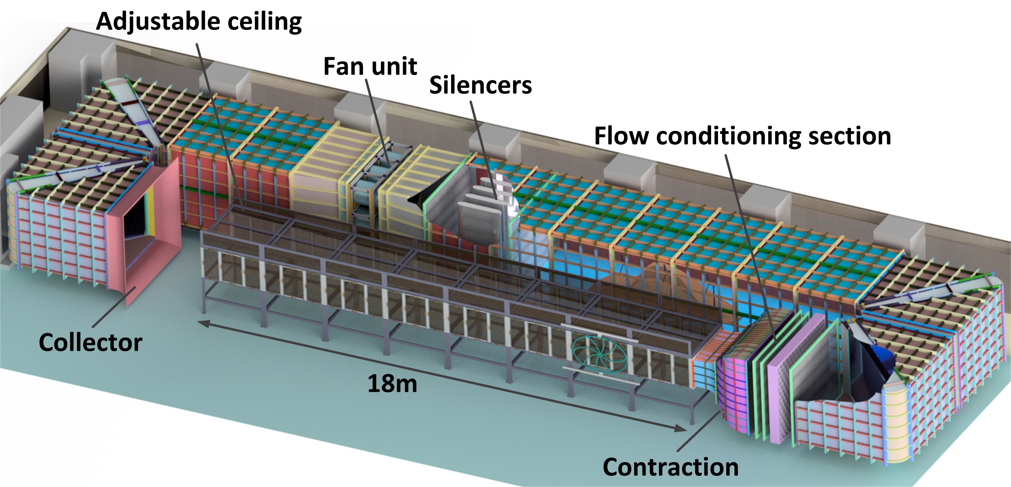
Boundary layer wind tunnel
18m long test section for flow development (1m/s to 30m/s)
Adjustable pressure gradient
2m (W) x 1m (H) cross-section for large-scale models
Additional capabilities
Low turbulence intensity (<0.1%)
6-axis force plate + dedicated drag balance (~0.1g sensitivity)
PIV, hotwire, steady and unsteady pressure measurements

Slide 8
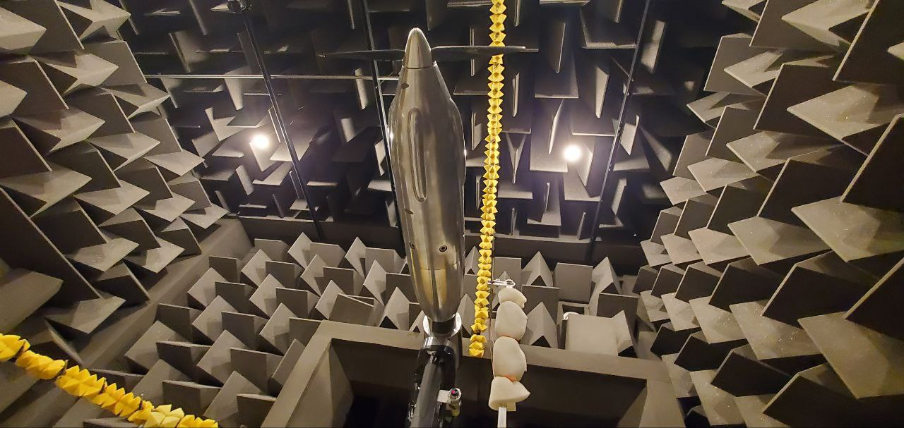
Thank you

