Slide 1
City, University of London
Handley Page Aeronautics Laboratory

Slide 2
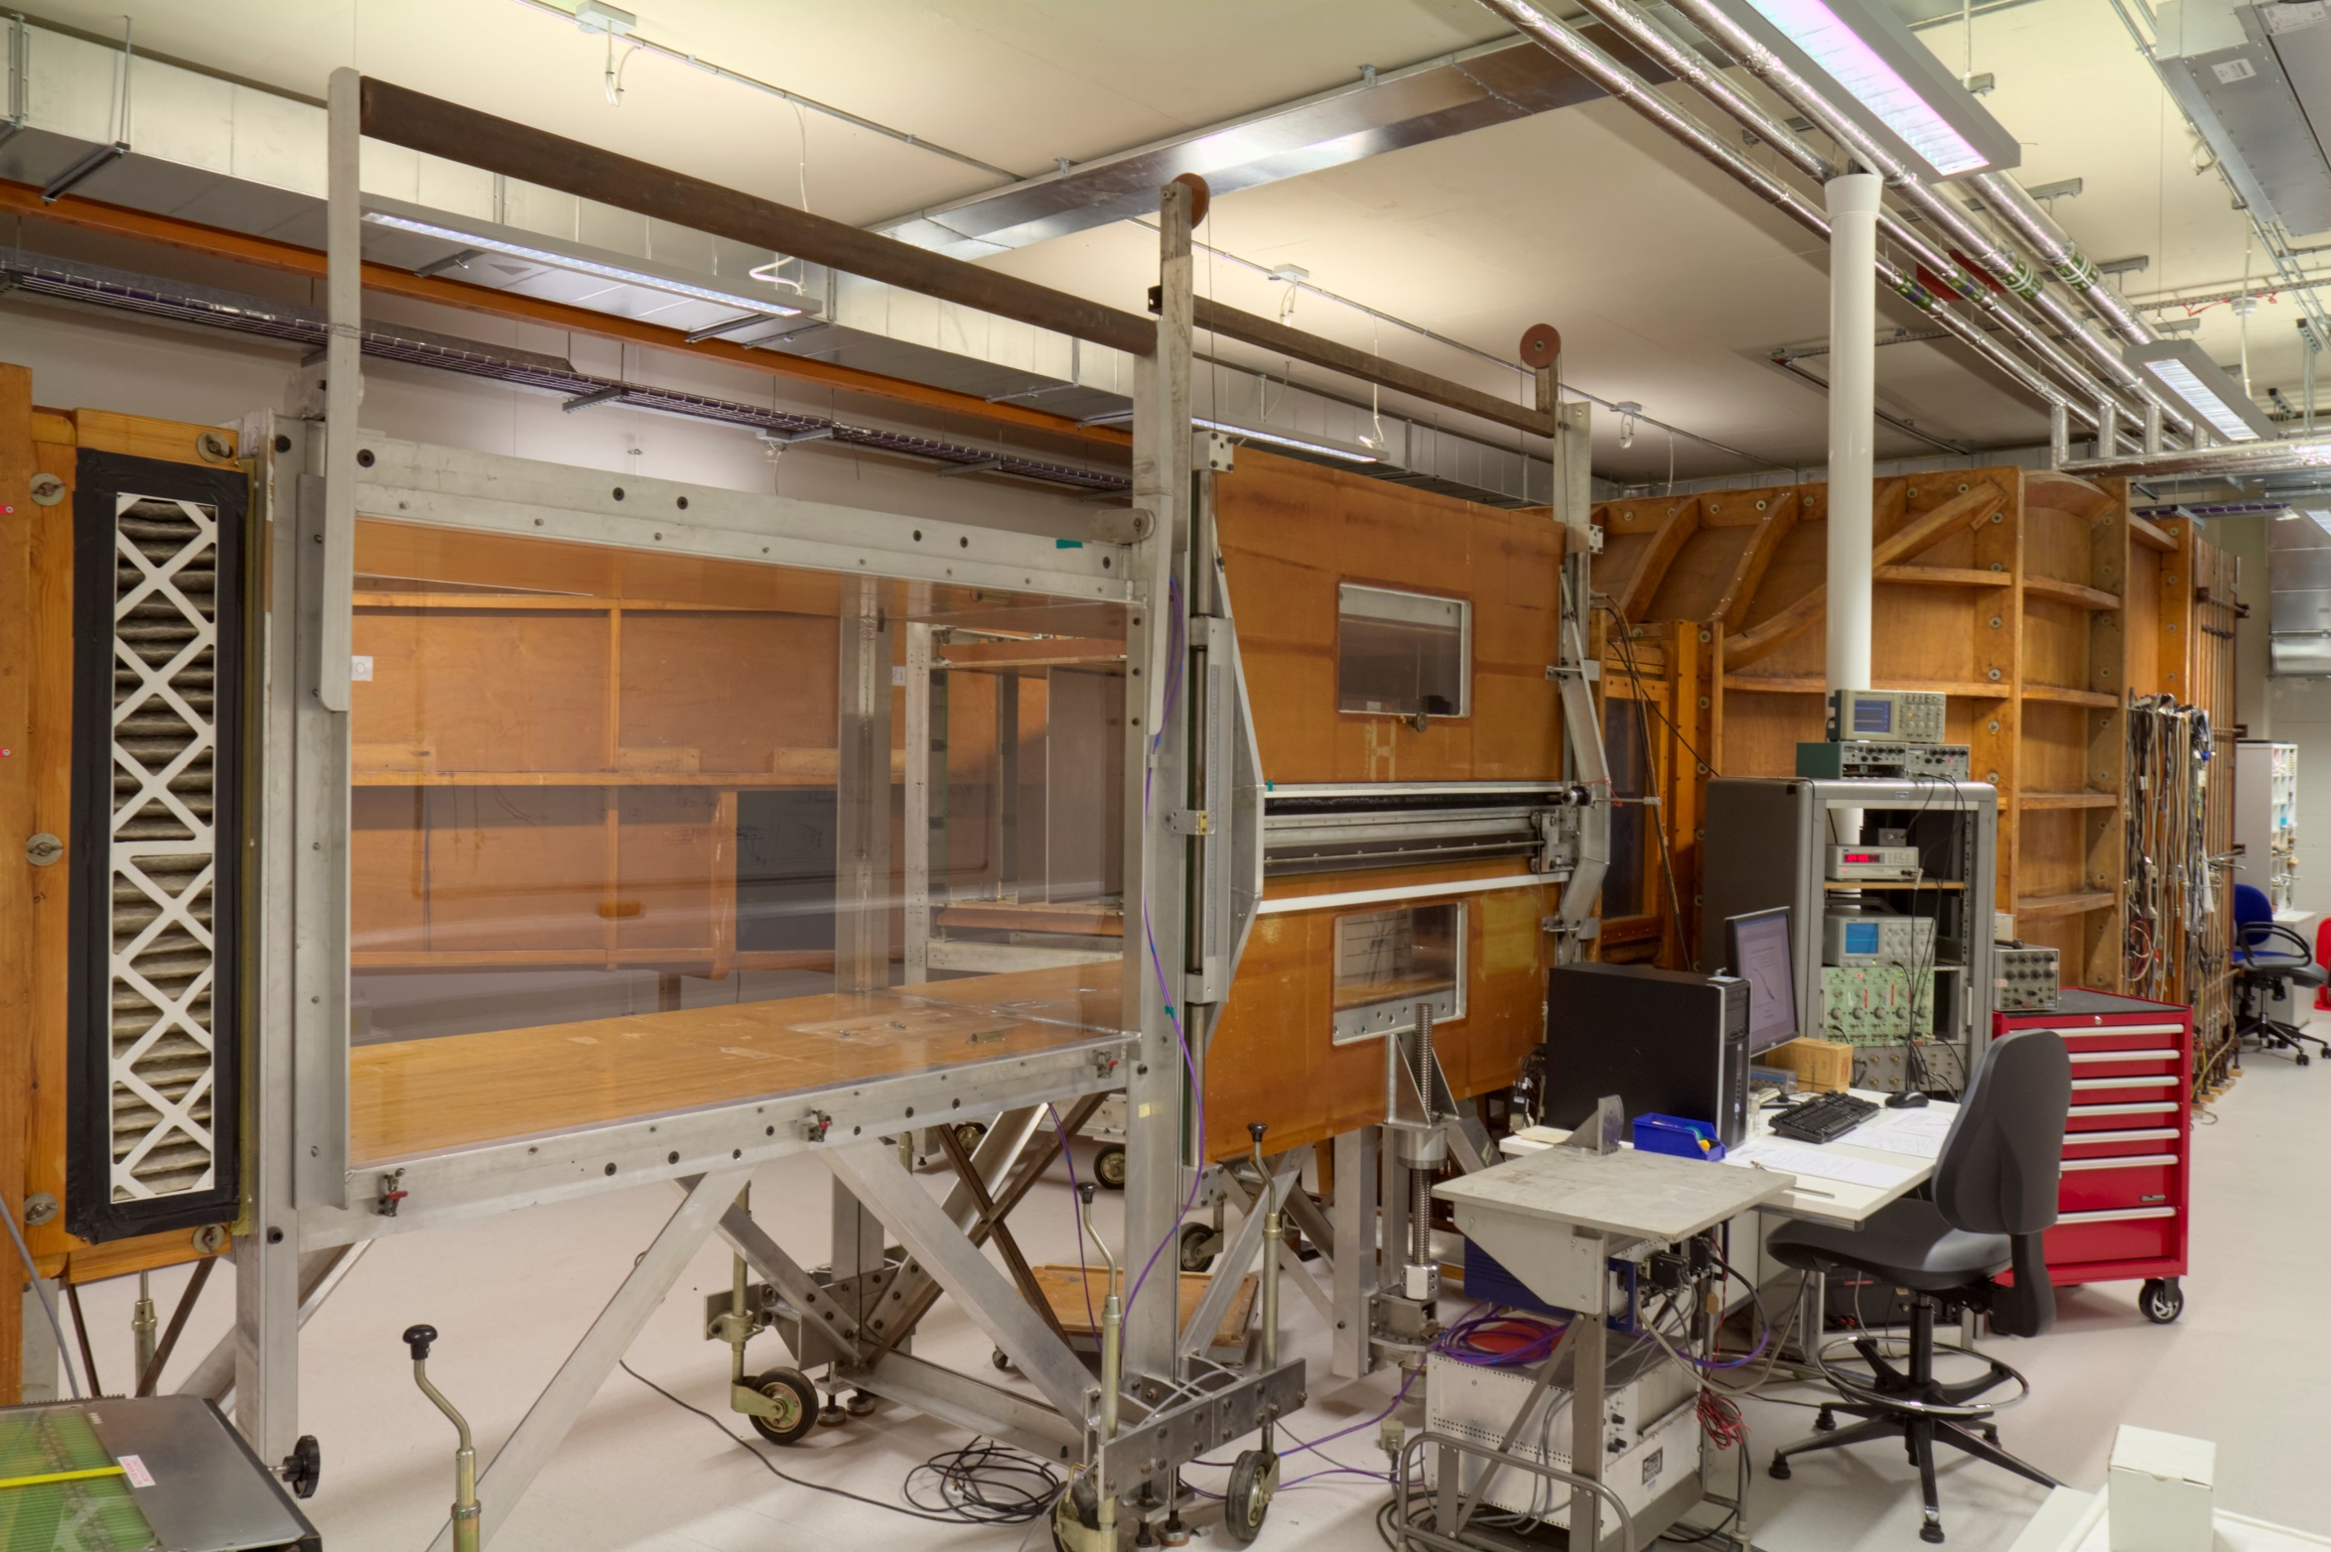
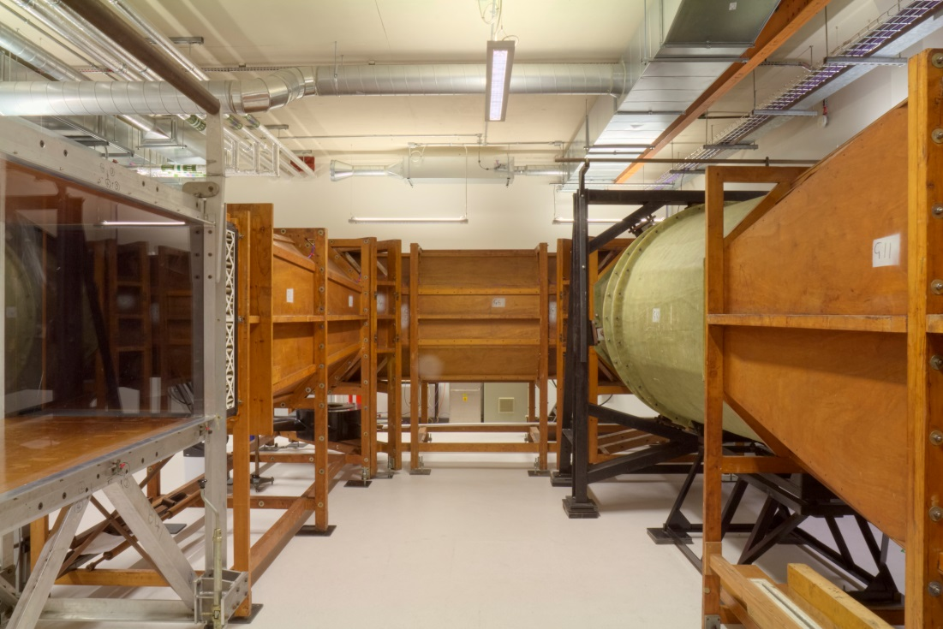
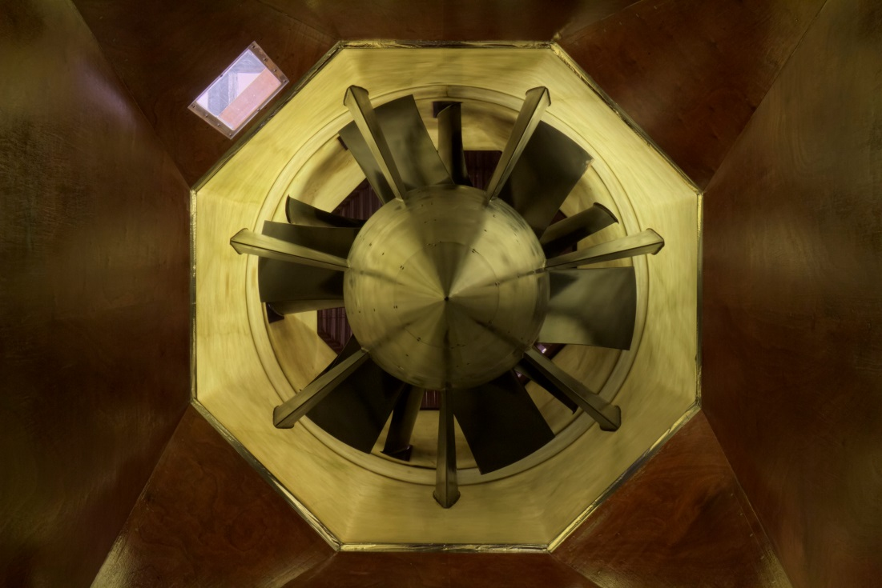
GASTER LOW-TURBULENCE WIND TUNNEL (NWTF)
Test Section Dimensions: 0.9m X 0.9m X m
Maximum Velocity: 30m/s
Turbulence Intensity: 0.007 %
Instrumentation: Thermal Anemometry, Pressure & Acoustic Transducers
Research Includes
Laminar Turbulent Transition – EPSRC, InnovateUK
Drag Reduction
Flow Control

Slide 3
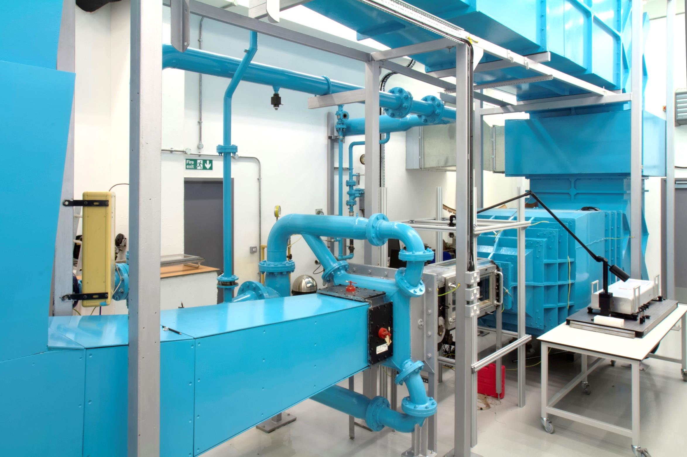
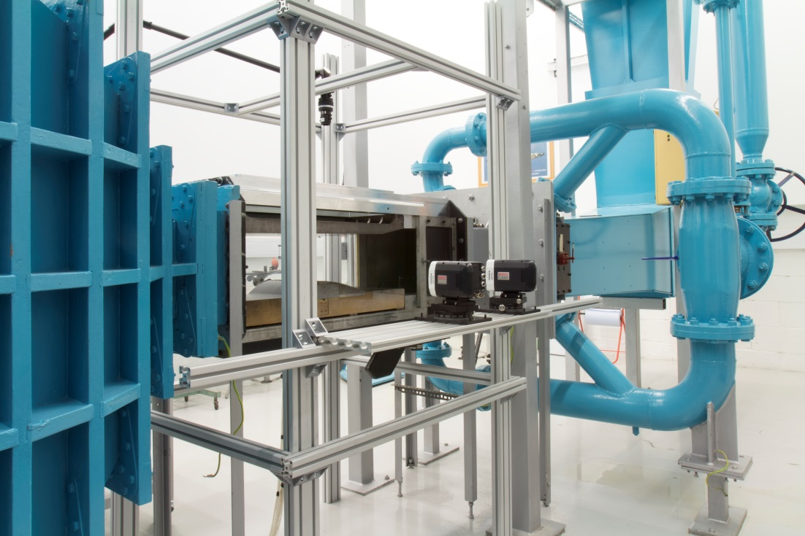
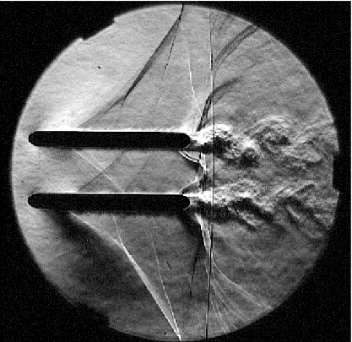
T-5 TRANSONIC WIND TUNNEL (NWTF)
Test Section Dimensions: 0.25m X 0.24m X 0.7m
Operating Velocity: Mach 0.5 – Mach 1.5
Instrumentation: Laser Diagnostics (3D LDA; Tomographic PIV), Thermal Anemometry, Pressure Transducers, High-Speed Flow Visualization : Schlieren, BOS
Research Incudes
Influence of Surface Quality on Drag – InnovateUK, EPSRC
Shock-wave Boundary Layer Interaction

Slide 4
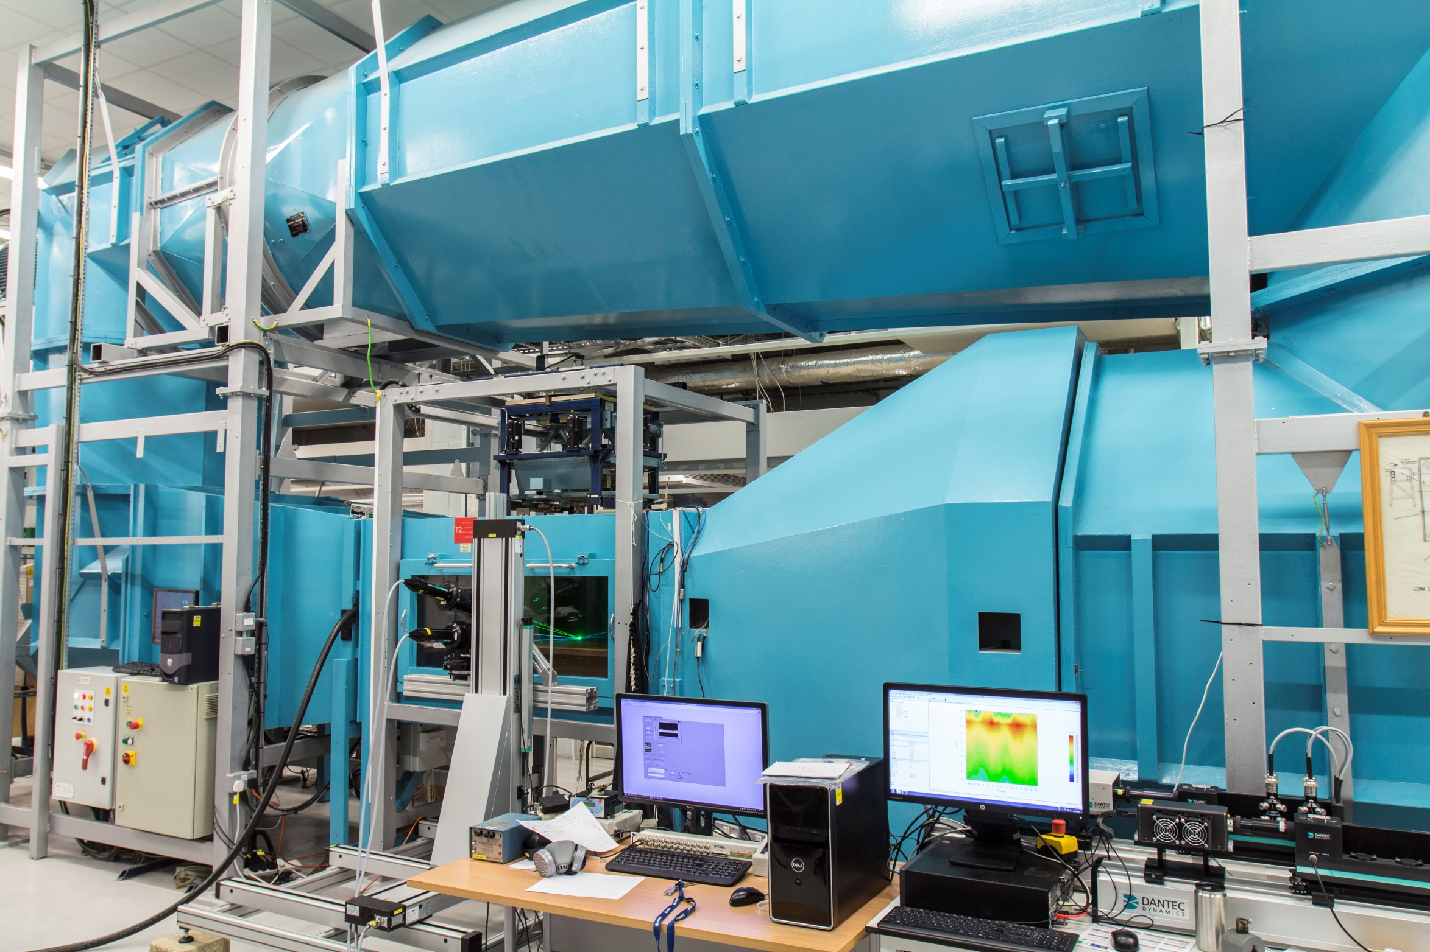
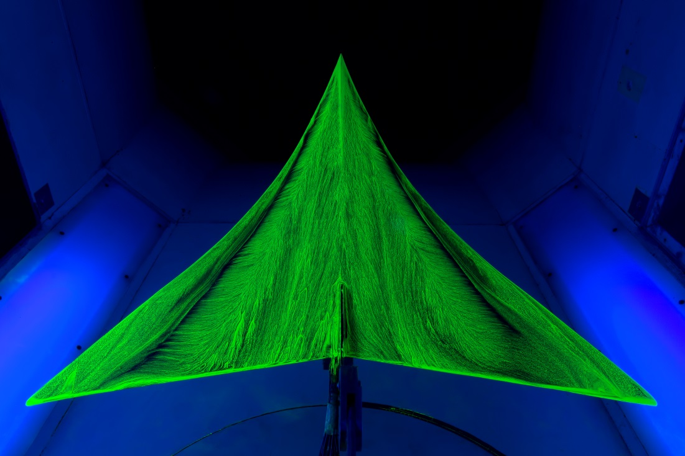
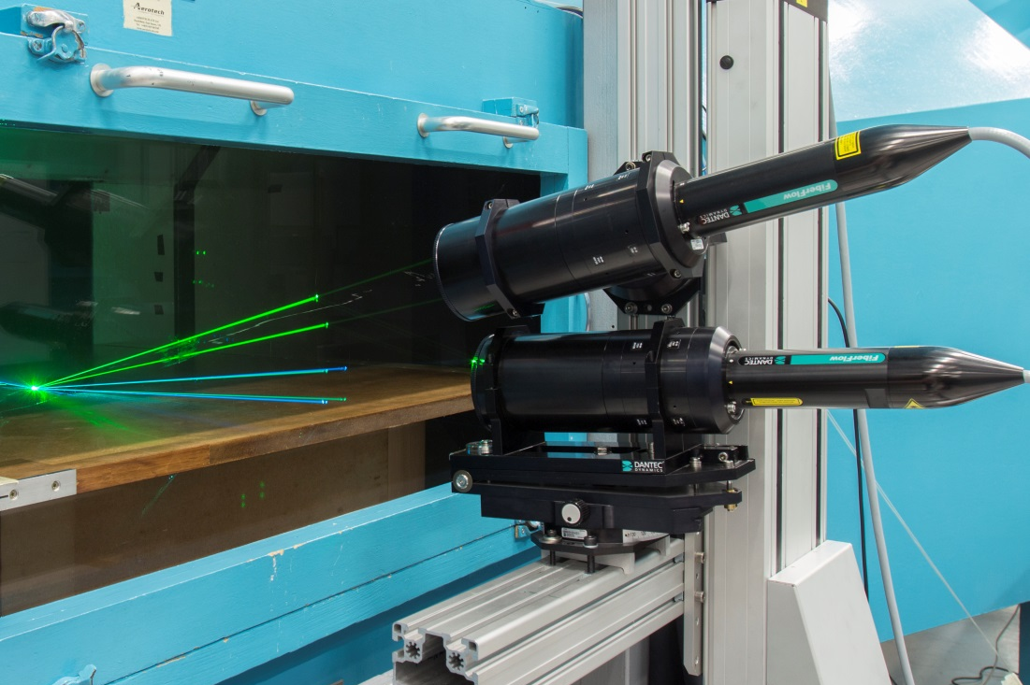
T-2 LOW-SPEED WIND TUNNEL
Test Section Dimensions: 0.8 m X 1.1 m X 1.8 m
Operating Velocity: 4 m/s – 55 m/s
Turbulence Intensity: 0.5 %
Instrumentation: Laser Diagnostics, Thermal Anemometry, Pressure Transducers, 6-Component Force Balance
Research Incudes
Influence of Surface Quality on Drag
Bioinspired Fluid Dynamics

Slide 5
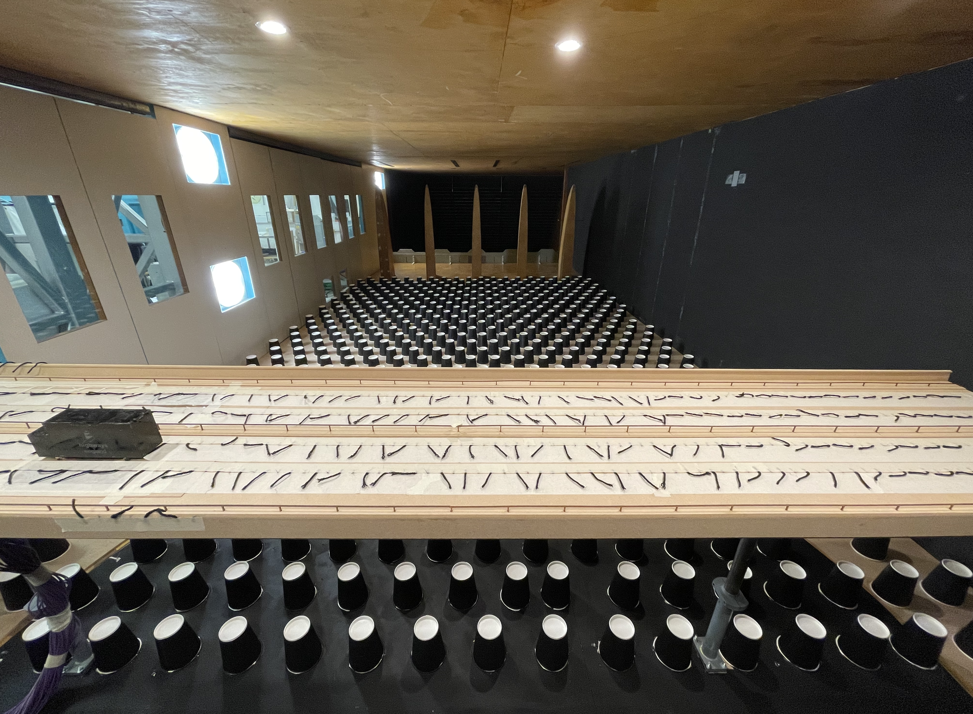
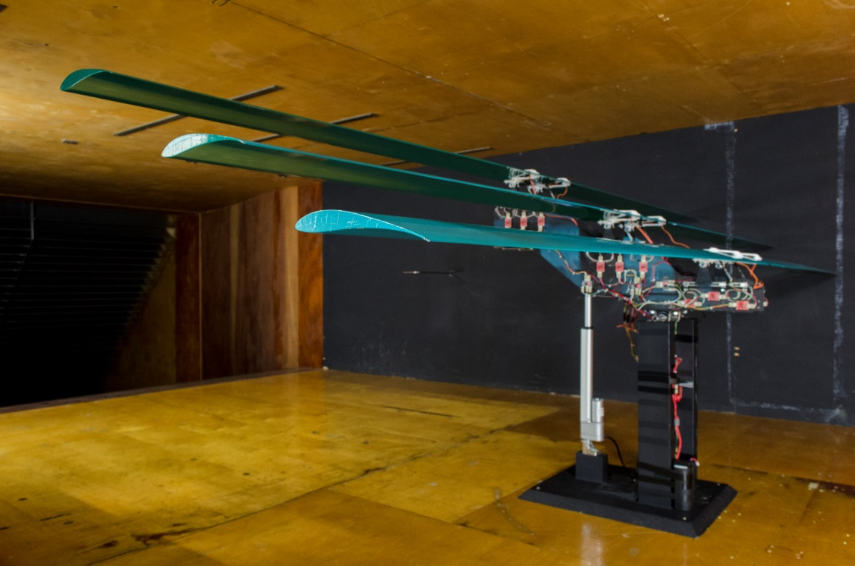
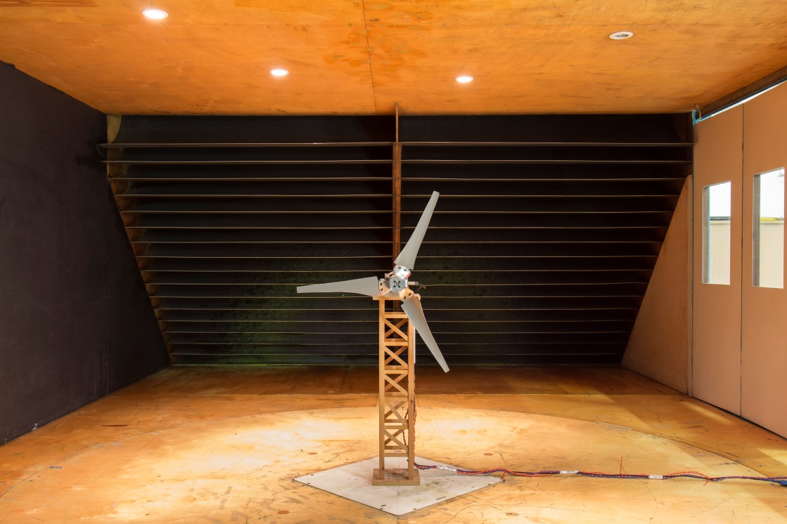
T-7 ATMOSPHERIC BOUNDARY LAYER TUNNEL
Test Section Dimensions: 1.5 m X 3 m X 8 m
Operating Velocity: 2 m/s – 25 m/s
Turbulence Intensity: ~1 %
Instrumentation: Thermal Anemometry, Pressure Transducers
Research Incudes
Influence of Wind Loading on Buildings and Bridges - InnovateUK
Building Aerodynamics and Pedestrian Comfort – Dept for Transport

