Slide 1
8x6 Wind Tunnel Cranfield University
Anderson Proença
Applied Aerodynamics Group, School of Aerospace, Transport and Manufacturing, Cranfield University
15th November 2023

Slide 2
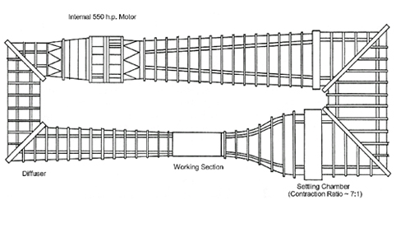
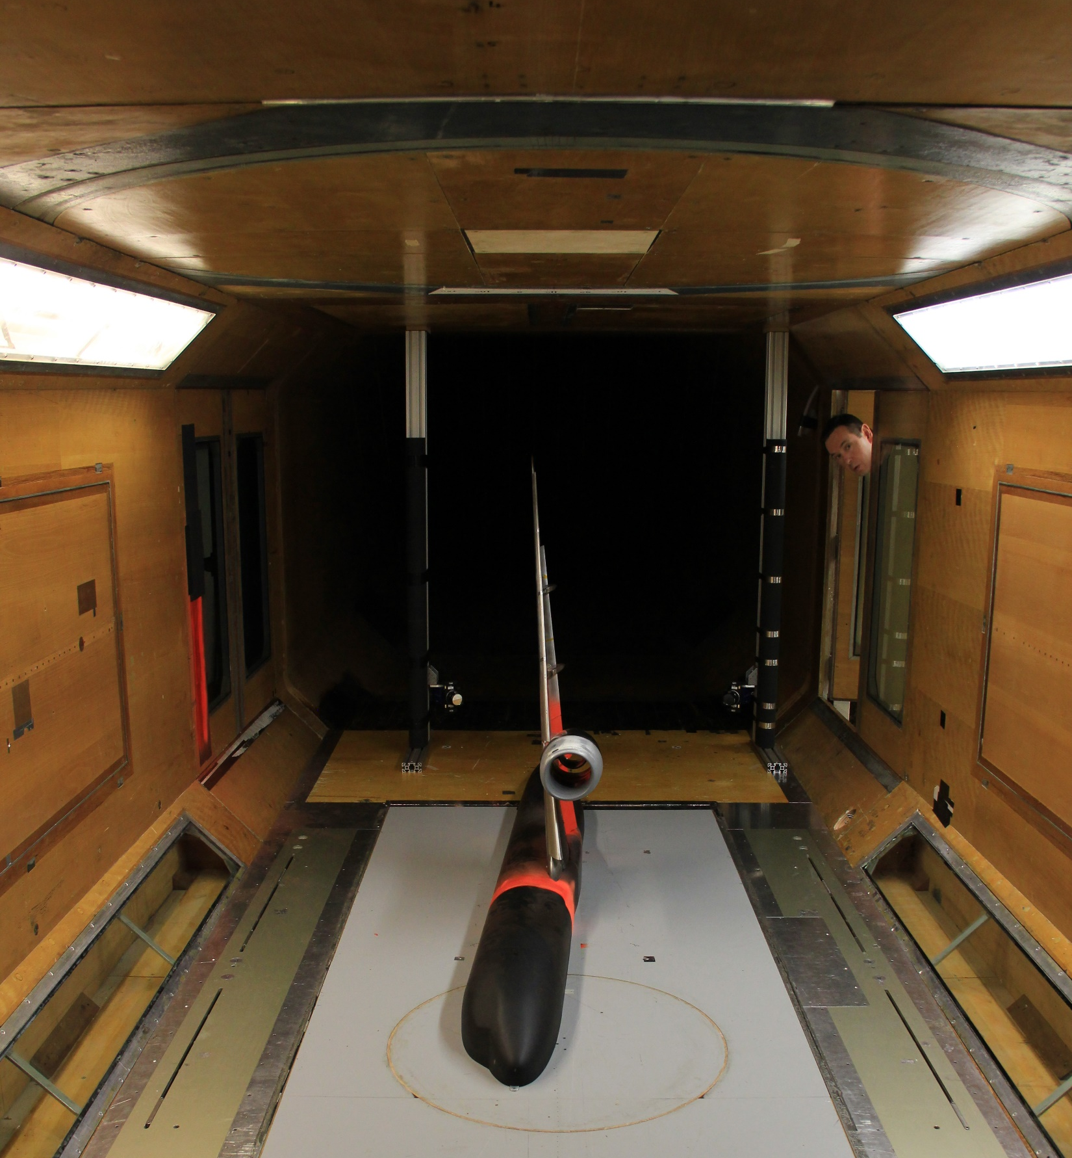
8x6 Wind Tunnel
This is a closed return, low turbulence wind tunnel with a rectangular working section
Test section: 8ft x 6ft; 17ft long (2.44m x 1.83m x 5.18m)
Powered by a 550 hp motor
Wind speed stable within $10≤U_{∞}≤45$ m/s
A two-stage suction system is employed for optimisation of the ground plane boundary layer
Equipped with an AEROTECH 6-component overhead balance mounted to a turntable
Also equipped with a moving ground (max speed 45 m/s)
Rotating wheels independently supported
https://www.youtube.com/watch?v=qkX3rkoYQ7I&ab_channel=NationalWindTunnelFacilities

Slide 3
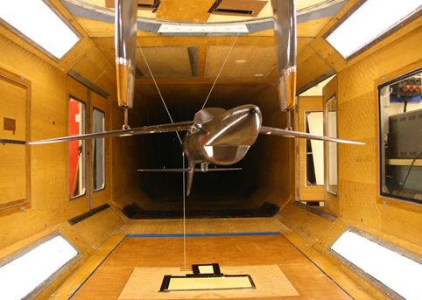
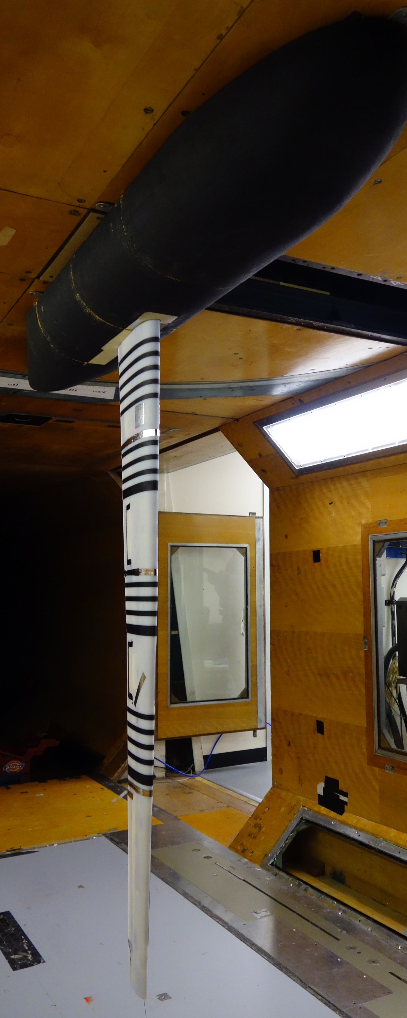
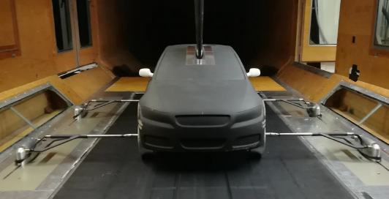
https://www.cranfield.ac.uk/facilities/8x6-wind-tunnel

Slide 4
Thank you!
A.Proenca@cranfield.ac.uk

