Slide 1
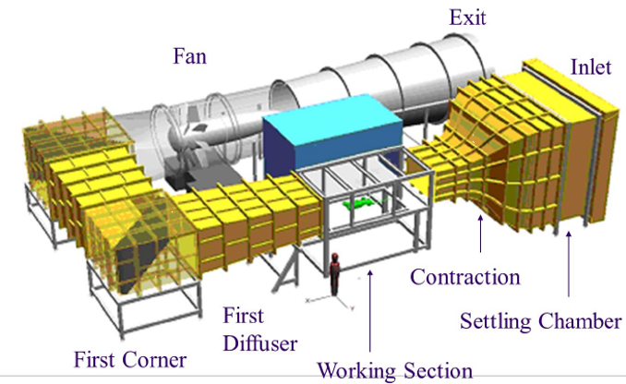
NWTF Automotive Tunnel
Department of Aeronautical & Automotive Engineering
Open circuit, closed section
  Maximise usage of 18 x 10 x 7.5 m footprint
  Minimise W/S losses and jet noise
¼ scale (automotive), 1 m wingspan (aero)
  1.92 m x 1.32 m x 3.6 m
40 m/s design speed (50 m/s max)
TI: 0.15% (CL) at 40 m/s
Boundary layer: 60 mm
Flow Uniformity: max 0.2% deviation from mean (CL)
Power: 140kW (max)

Slide 2
Instrumentation
6-component, virtual centre Aerotech balance
  Max 860 mm x 760 mm (Wheelbase x Tr). 30kg max model
  Load range: +/- 120 N (drag), +/- 500 N (lift), +/- 420 N (side)
  Accuracy: 0.010% (drag, lift), 0.005% (side)
Scanners & Probes:
  3 x CanDAQ 300 Hz, 64 channel pressure scanners
  Kulite High-speed pressure sensors
  TSI Cobra probe (3000 Hz)
Optical Instrumentation
  200 mJ double-pulse Nd:YAG (15 Hz)
  2D2C, 2D3C, 3D3C (Tomo) PIV set-ups

Slide 3
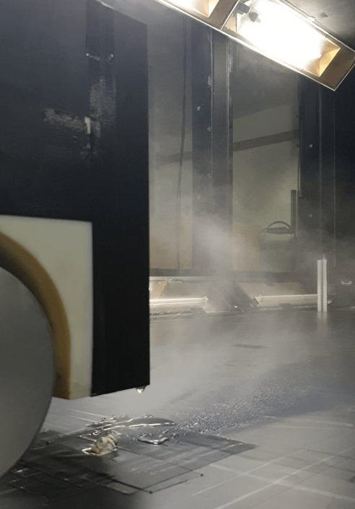
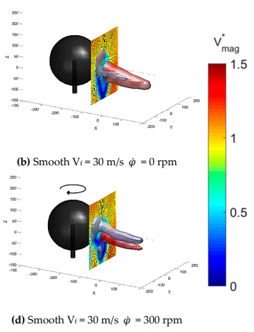
Recent Highlights
LEFT: Crickmore, C., Garmory, A., and Butcher, D., "Experimental Analysis of Spray Topology in the Wake of an Automotive Body," SAE Technical Paper 2023-01-0793, 2023, https://doi.org/10.4271/2023-01-0793
RIGHT: Ward, M.; Passmore, M.; Spencer, A.; Harland, A.; Hanson, H.; Lucas, T. Comparing the Aerodynamic Behaviour of Real Footballs to a Smooth Sphere Using Tomographic PIV. Proceedings 2020, 49, 150. https://doi.org/10.3390/proceedings2020049150

Slide 4

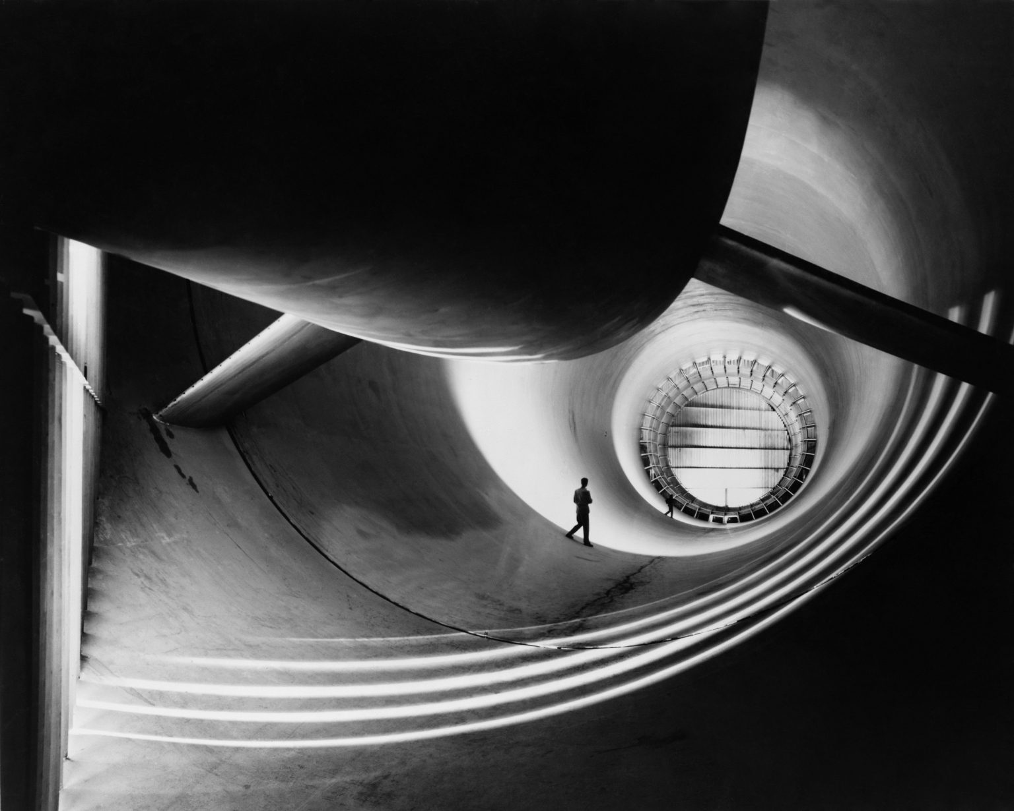
National Wind Tunnel Facility Experimental Database
Prof Gary Page
Dr Dan Butcher
Dr Dhamotharan Veerasamy
Aeronautical & Automotive Engineering
Loughborough University

Slide 5
Aim + Objectives
Aim to be the first place researchers look for aerodynamic data
  Both UK and International
Promote UK aerodynamics data and ensure it is utilised
Improve integration of experiment and computer simulation to solve problems
Establish guidelines, best practice and standards that can be adopted by others

Slide 6
Experimental Database Plan
Will create exemplar descriptions and data sets based on existing Loughborough data
Work with other Universities to create equivalent high quality descriptions and data sets
Produce a best practice guide, templates etc.
Publicise data
NWTF will only host meta data (descriptions)
  Underlying data will stay on University repositories (archived, DOI etc, Open Access license)

Slide 7
Progress so far / Next steps
Associate recruited: Dr Dhamo Veerasamy at LU
Survey at conferences: NWTF and UKTC 2023
  Important database characteristics, requirements etc
Survey of university repository systems
Standard template for upload being developed
2 – 3 LU datasets identified for upload covering a number of measurement techniques and therefore data types
Work with initial groups to help upload your data and make available through this format
Share guide and upload process more widely

