Slide 1
High SuperSonic Tunnel Testing Capabilities

Slide 2
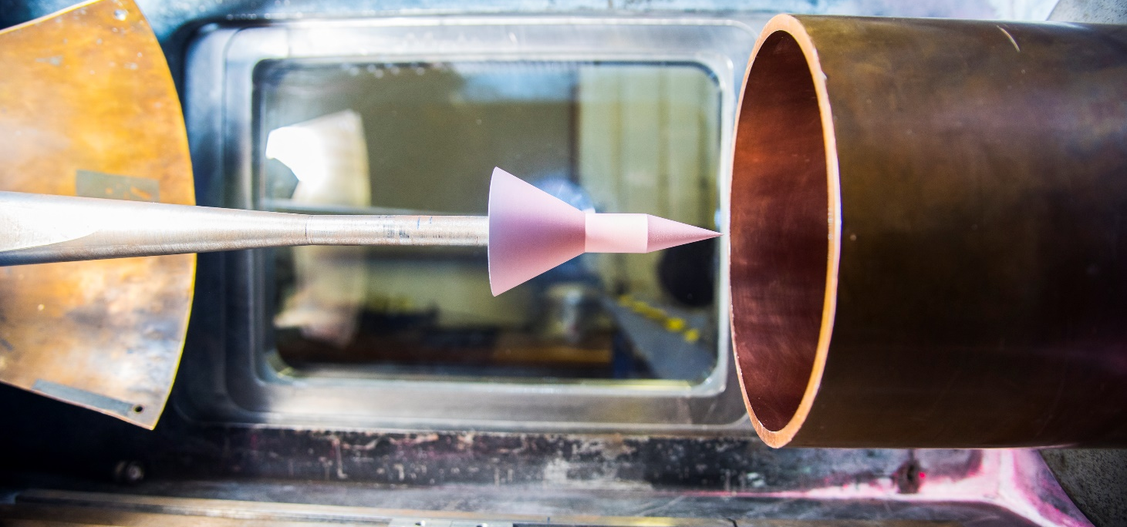
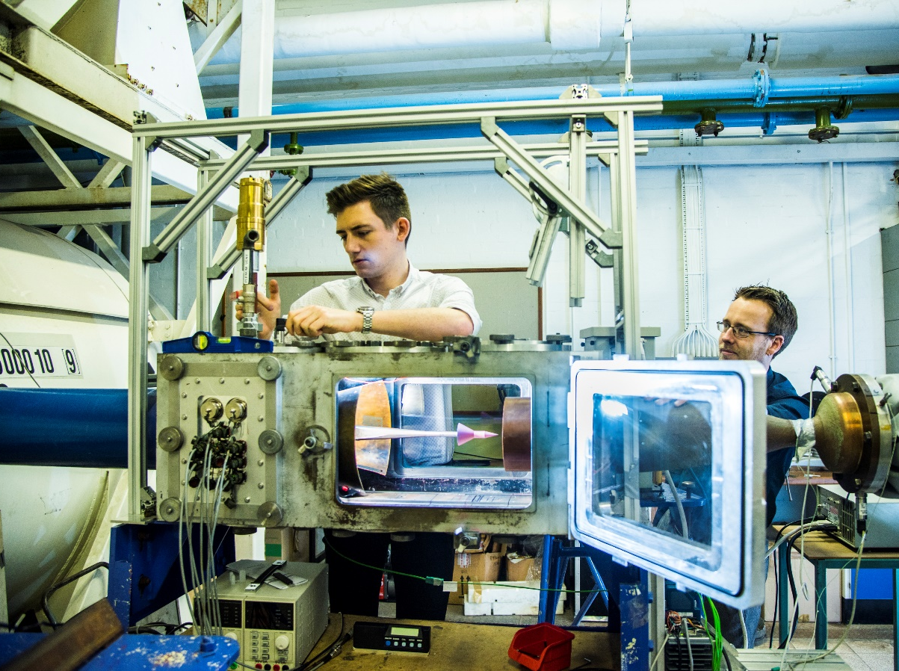
Mach number range: 4, 5, 6
Long run time: 7.5 seconds at Mach 5
Nozzle exit diameter: 152 mm
Reynolds number range up to 25 million/metre
Total pressure: up to 8.5 bar @ Mach 5
Total temperature: 300-950K
Full and Half model testing
Three-component balance

Slide 3
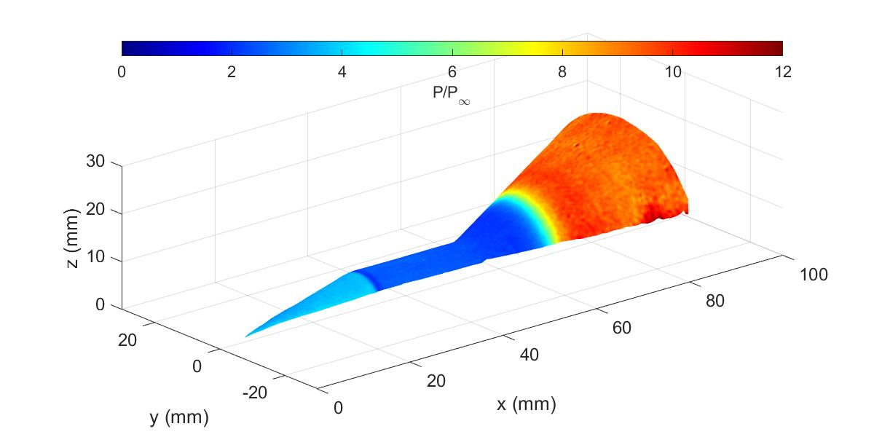
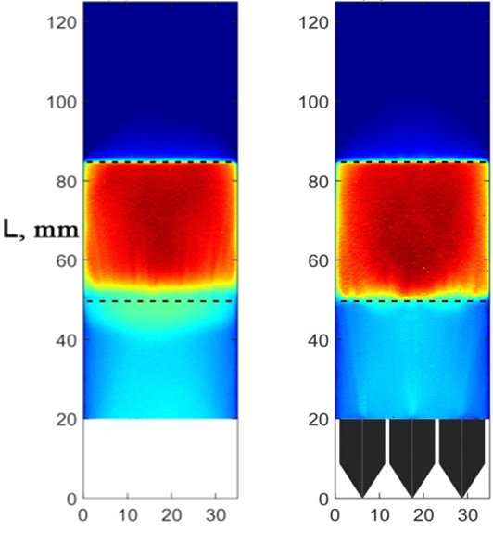
PSP/Schlieren

Slide 4
Good and could be better
(nearly) unique facility in the UK
Wide range of experimental techniques
Qualified and capable and young(ish) staff
Not true hypersonic – no thermal effects
Availability of suitable replacement parts for improvements, particularly the pre-heater
Vaguely uncertain future for the building it’s in

