Slide 1
Oxford’s Hypersonic Test Facilities
NWTF Tunnel Managers Meeting. 15th November 2023.
Chris Hambidge.

Slide 2
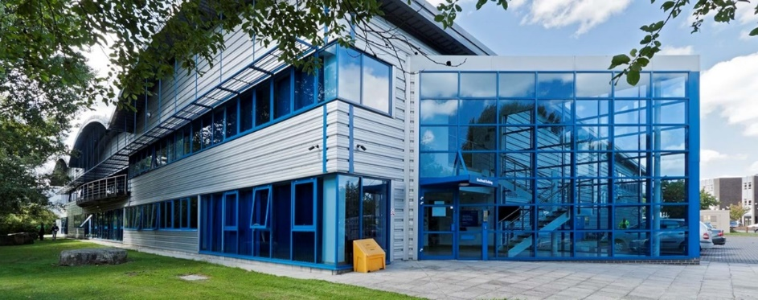
The Hypersonics Group
Hypersonics
2013: Group Created
2014: NWTF Funding
2016: 1 Academic, 1 post-doc, 2 PhD students
2023: 7 Academics, 6 post-docs, 22 PhD students,
2 research engineers, Tunnel Team
Southwell Laboratory / Oxford Thermofluids Institute
Around 200 Students and Staff
Established 1960s – Heat Transfer
Rolls Royce UTC
1 Mile outside Oxford Centre
Tunnel Team
80% - 20%
Experimental Numerical
TRL: 1 2 3 4 5
70% - 15% - 15%
Academic Industrial Industrial
Project Project Service

Slide 3
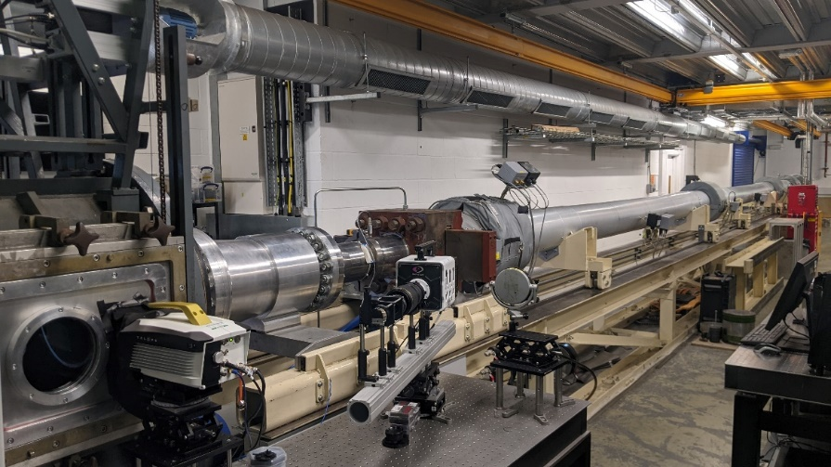
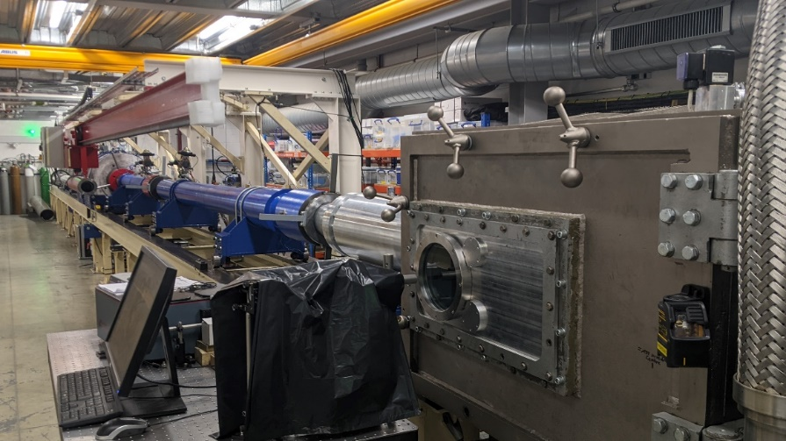
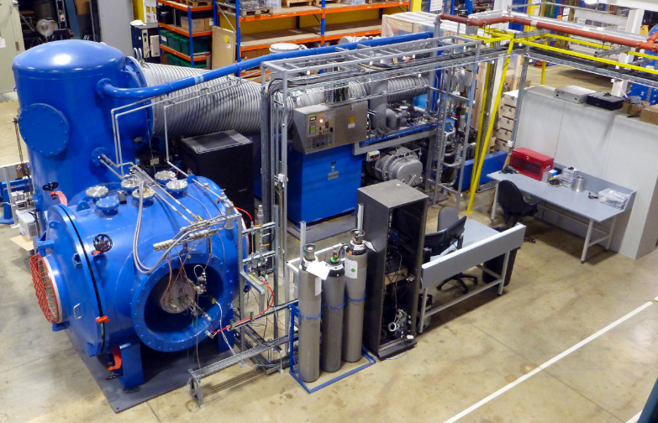
The Tunnels
High Density Tunnel
T6 Stalker Tunnel
Low Density Tunnel
2x Tier 1 NWTF Tunnels HDT & T6
1x Tier 2 NWTF Tunnel LDT
1x NWTF+ Hypersonic Tunnel HQT
4x Smaller Hypersonic Facilities CDST, CXT, OPG1 & OPG2

Slide 4
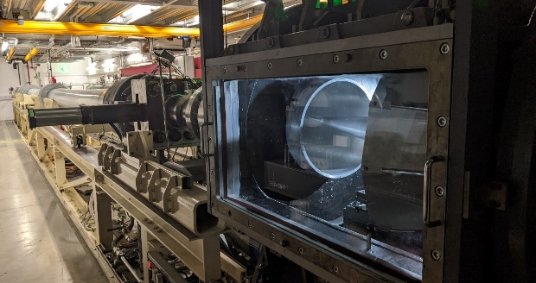
High Density Tunnel (HDT)
Heated Ludwieg Tunnel
Constructed & Commissioned: 2014-2016
Shots to date: 3350 [1 Shot/hour]
Typical test campaign: 2-4 weeks
Mach: 4 – 7, Nozzle Exit 350mm. +M3*
P_{0 max} = 275 bar, T_{0 max} =550K
Typical Operating Range: 20-100bar, 500K
Typical Re_{u}: 5x10⁶ to 100x10⁶/m
Steady Test Periods: 3-7 of 30 to 50ms.
Plenum Augmented Ludwieg Mode (PALM).
→ 2s ‘steady’ test time.
→ Expense of P₀
Light Isentropic Compression Heating (LICH) → T₀ up to 1200k
→ Expense of P₀ and Test Time

Slide 5
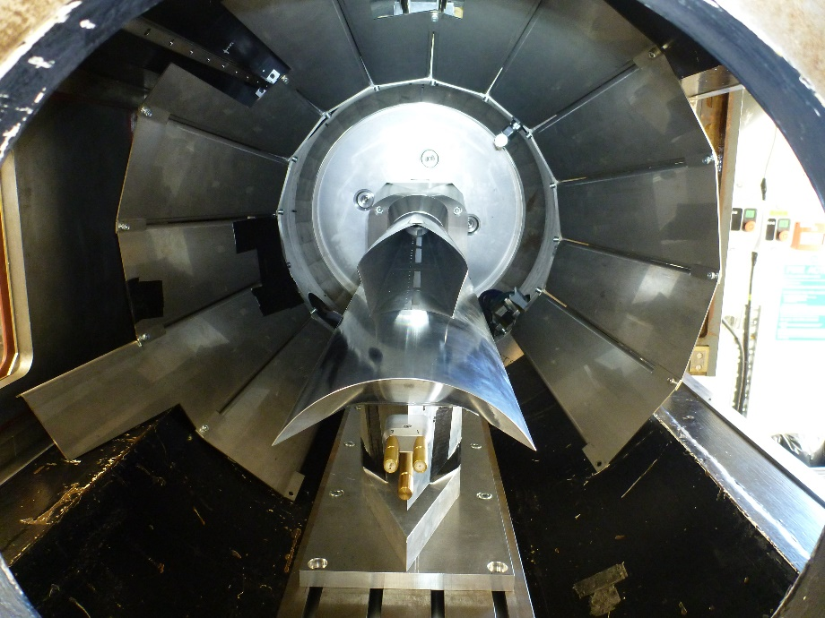
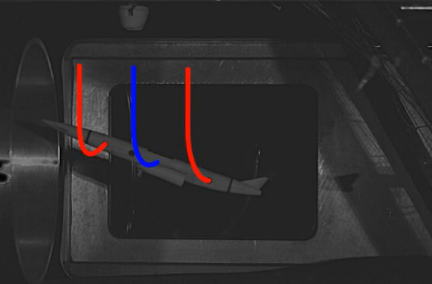
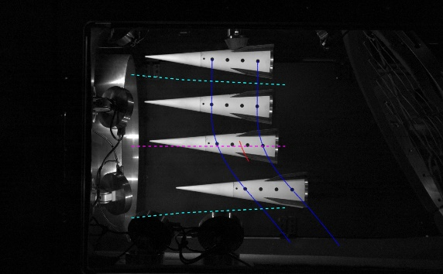
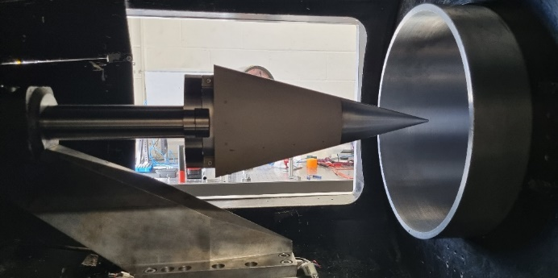
High Density Tunnel (HDT)
Scramjet Dynamics
Transition Mechanisms
Transpiration Cooling
Heat Flux Augmentation
(Patterned Roughness, Engineering Features)
Flight Dynamics
High-Speed Schlieren up to 1.75 Mfps
Focussed Laser Differential Interferometry (FLDI)
Laser Induced Grating Spectroscopy (LIGS)
Pressure Sensitive Paint (single and two colour)
Fast Response Pressure Sensors (Kulite and PCB)
High-Speed MWIR up to 1 Mfps
Bespoke Thin Film Heat Transfer Gauges
Free-Flight Inertial Force Measurement
High-Speed Motion Tracking up to 1.75 Mfps
Fast-Response Force Balances: 1x 6DOF, 2x 4DOF.
Bespoke Scramjet Mass Capture Device
Bespoke Shear Measurement Device
Secondary Gas Injection System + Mass Flow Control
Two-Axis Traverse
Rakes/Plates/Cones
Scramjet Intake Testing
Free-Flight Testing
Bespoke Heat Transfer Gauges
Elliptical Cone Model (HiFire 5)

Slide 6
High Density Tunnel (HDT)
Scramjet Dynamics
Transition Mechanisms
Transpiration Cooling
Heat Flux Augmentation
(Patterned Roughness, Engineering Features)
Flight Dynamics
Scramjet Intake Testing
Free-Flight Testing
Bespoke Heat Transfer Gauges
Elliptical Cone Model (HiFire 5)

Slide 7
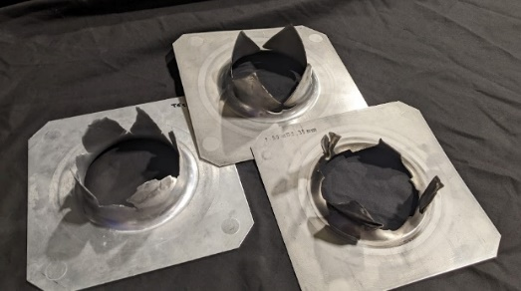
The Stalker Tunnel (T6)
Free-Piston Driven Multi-Mode Shock Tunnel
Constructed & Commissioned: 2014 - 2018
Shots to date: 500 [1 Shot/day]
Typical test campaign: 4-6 weeks
Nozzles: M7, M8, M10, Nozzle Exit 96 to 280mm.
Flow Speed: up to 18km/s
Operating Range
1,500 K < T₀ < 20,000 K
10 MPa < P₀ < 1000 Mpa
Flow Duration: 2 μs to 5 ms.
Mode 1: Straight Through
Shock Tube*
→ Max Speed 18 km/s
→ Test Time 2-50 μs
Mode 2: (Aluminium) Shock Tube*
→ Low carbon contamination
→ Boundary layer effects reduced
→ Max Speed 12 km/s
→ Test Time 2-50 μs
Mode 3: Expansion Tube/Tunnel*
→ Max Speed 12 km/s
→ Test Time 50-500 μs
Mode 4: Reflected Shock Tunnel
→ Max Speed 6.5 km/s
→ Test Time 1-5 ms

Slide 8
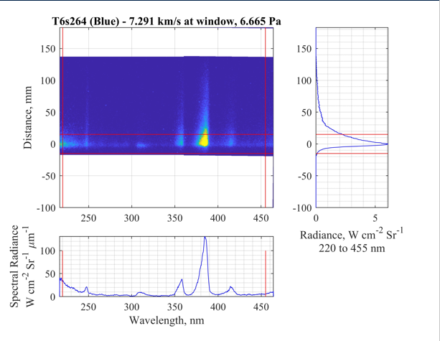
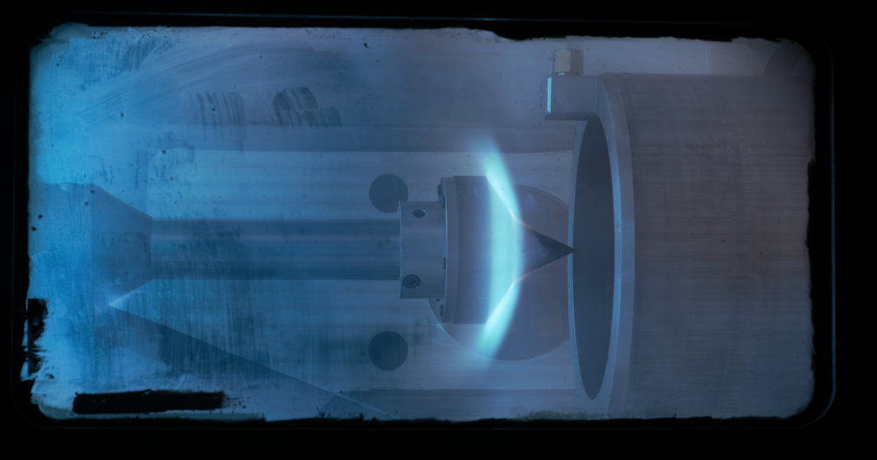
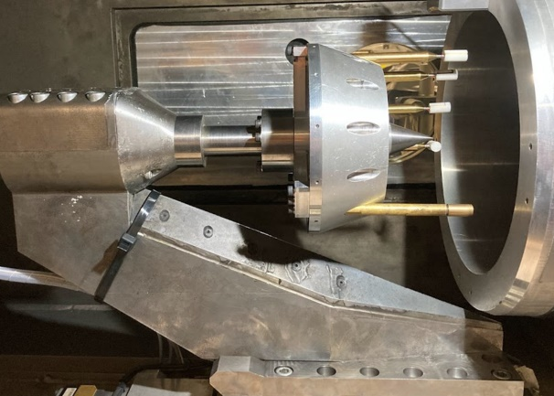
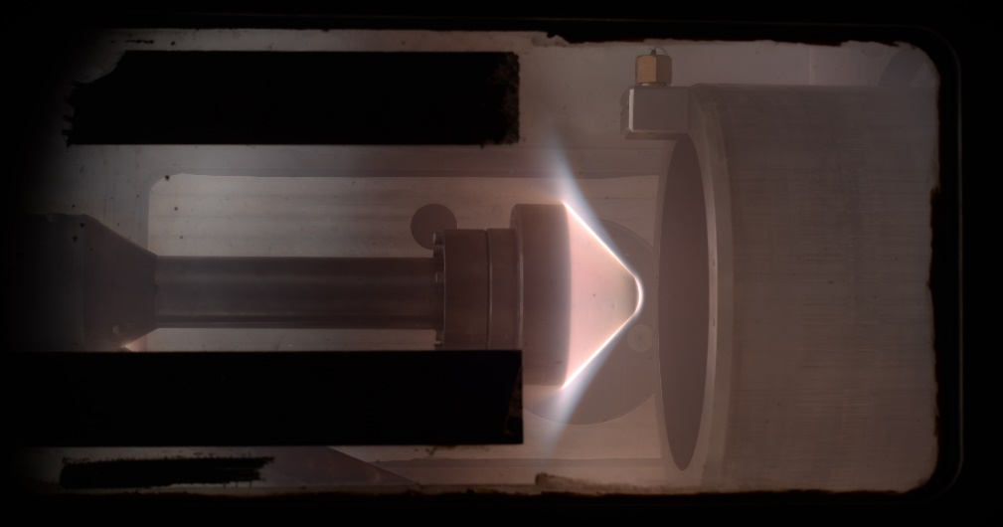
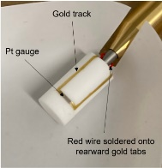
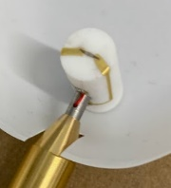
The Stalker Tunnel (T6)
Non-Equilibrium Thermochemistry
Planetary Entry Aerothermodynamics
Satellite demise, Planetary Probes, Capsules
Inter-Facility Comparisons (EAST) & CFD Validation
Visible, Near-IR Spectroscopy
Vacuum Ultra-Violet Spectroscopy
Atmosphere Gas Composition Matching (Inc Flammable gas)
LEO Return ~11km/s
Mars Return ~16km/s
Gas Giant Entry ~19km/s (*30km/s)
Bespoke Diamond Heat Transfer Gauges
Non-Equilibrium Flow behind a shock wave at
7.3 km/s for Mars entry (95.8% CO2 / 4.2% N2)
Double-cone model tested in Expansion Tunnel mode
at 6.3 km/s (19.8 MJ/kg) for earth entry.
Satellite demise heat transfer testing at 6.5 km/s for LEO return.
Sub-scale Galileo model tested at
18.0 km/s for Neptune entry (84.5% H₂ / 15% He / 0.5% CH₄).

Slide 9
The Stalker Tunnel (T6)
Non-Equilibrium Thermochemistry
Planetary Entry Aerothermodynamics
Satellite Demise, Planetary Probes, Capsules
Inter-Facility Comparisons (EAST)
& CFD Validation
Non-Equilibrium Flow behind a shock wave at
7.3 km/s for Mars entry (95.8% CO2 / 4.2% N2)
Double-cone model tested in Expansion Tunnel mode
at 6.3 km/s (19.8 MJ/kg) for earth entry.
Satellite demise heat transfer testing at 6.5 km/s for LEO return.
Sub-scale Galileo model tested at
18.0 km/s for Neptune entry (84.5% H₂ / 15% He / 0.5% CH₄).

Slide 10
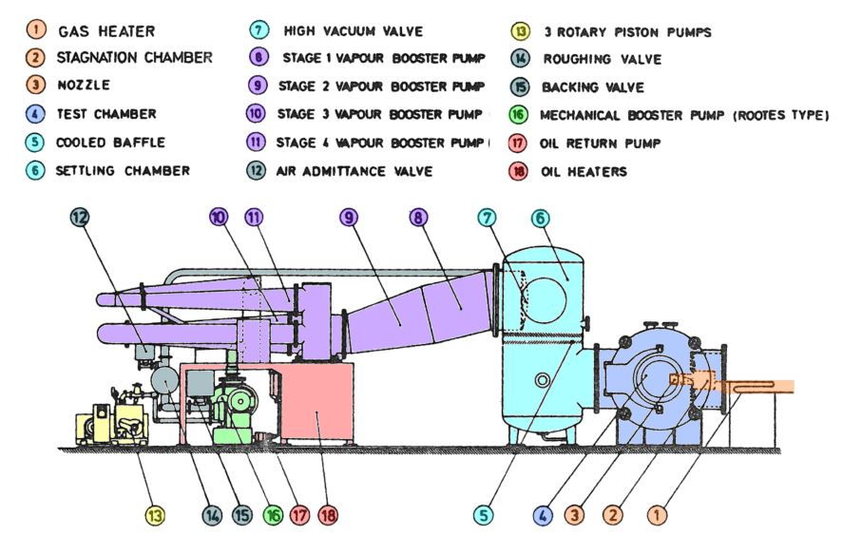
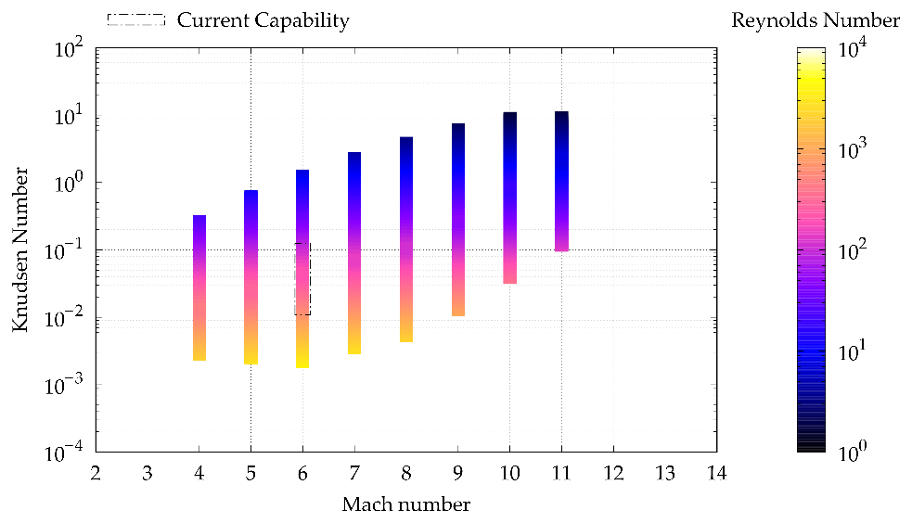
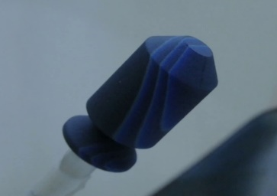
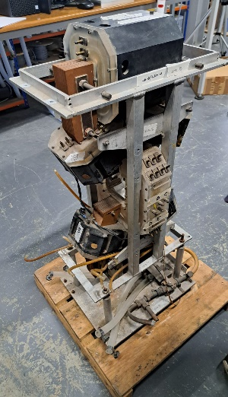
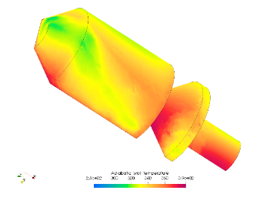
Low Density Tunnel
Free-Molecular
Transition
High Altitude Aerothermodynamics
Satellite Demise
Planetary Surface Analogy (Mars)
Slip
Continuum
L=10mm
Recommissioned: 2014-2016
Rebuilding capability
Mach: 6, Nozzle Exit 108mm, core flow 36mm
1.5 m Diameter Test Section.
T_{0 max} =523K
Continuous Operation
Kn 0.0005 to 1 for L=10mm
Raw camera image of upper-stage satellite analogue coated with a 3-temperature liquid crystal slurry at Ma = 5.8, Kn ≈ 0.02.
Magnetic suspension balance (subject of NWTF+)

Slide 11
Strengths/Challenges
Strengths:
Unique Capabilities
Range Test Capabilities In One Place
Affordable Hypersonic Ground Testing
Training of Future Experts
Access to Expertise
Challenges:
Short Duration (Instrumentation Complexity & Cost)
Wide Operational Pressure Range (High Pressure to Medium/High Vacuum)
Capacity (Short Test Slots with Regular Reconfiguration)
Space (inc. Co-location of T6 & HDT)
Recruiting and Maintaining Staff
Bootstrapping a Professional Service

