Slide 1
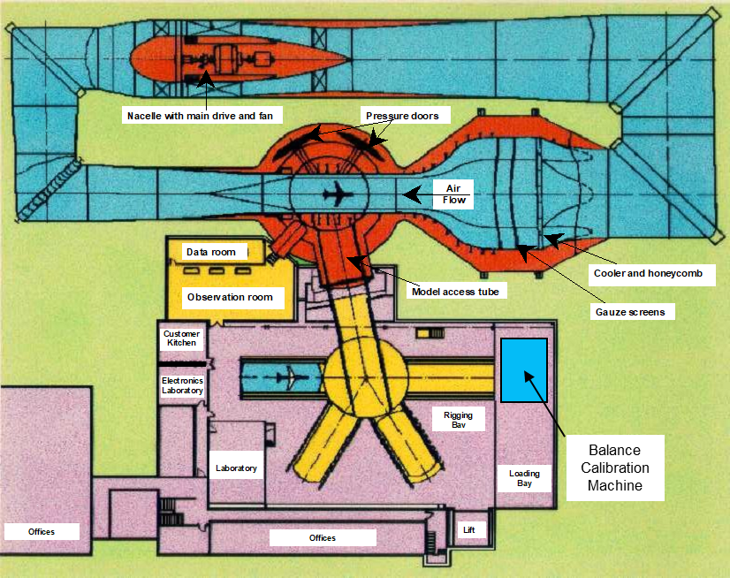
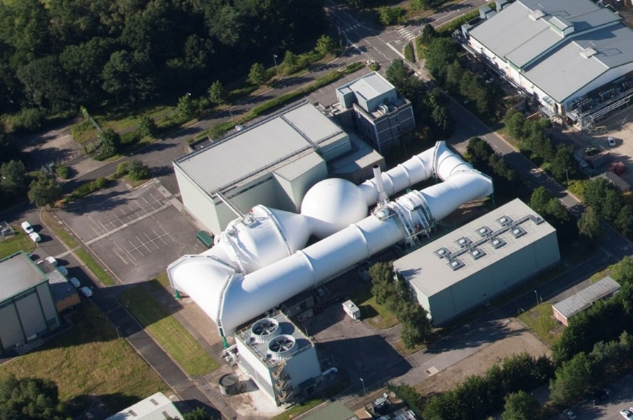
5m Wind Tunnel, Farnborough, Hampshire
Facility overview
Built in the 1970s – first run 1977
Working section size: 5m x 4.2m x 12.2m (16ft 5in x 13ft 9in x 40ft)
Tunnel pressurisation: atmosphere to 300kPa (43.5psi)
Maximum flow speed: M = 0.33 at atmosphere M = 0.27 at 300kPa
Operating temperature: 20 - 30°C (68 - 86°F)
Main drive fan: 11MW (14,750hp) AC motor 1.6MW (2,200hp) DC motor 10m diameter, 10 fixed pitch blades 310 rpm max
Primarily used for take-off and landing configuration development for commercial aircraft.

Slide 2
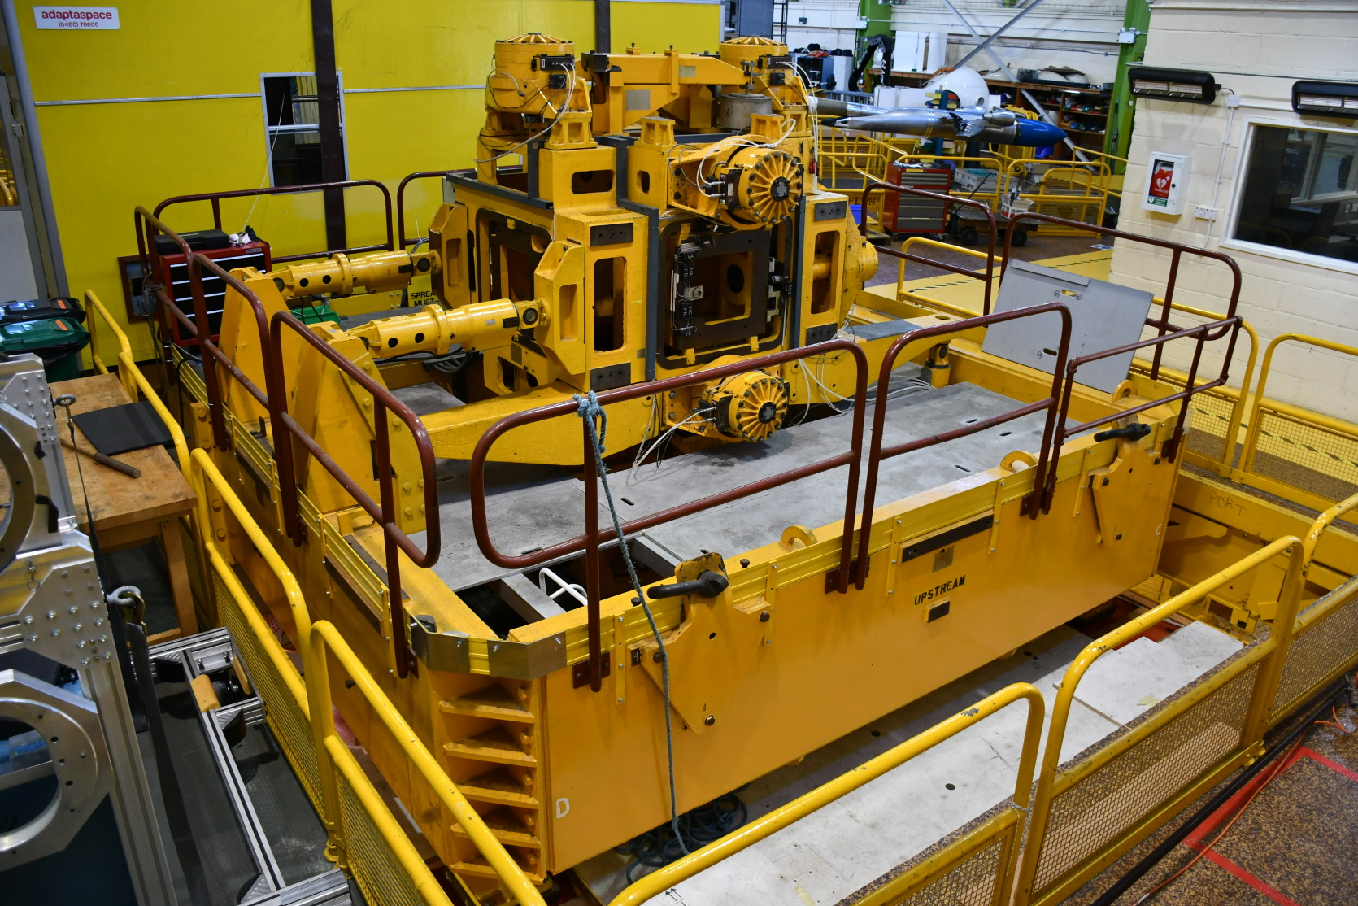
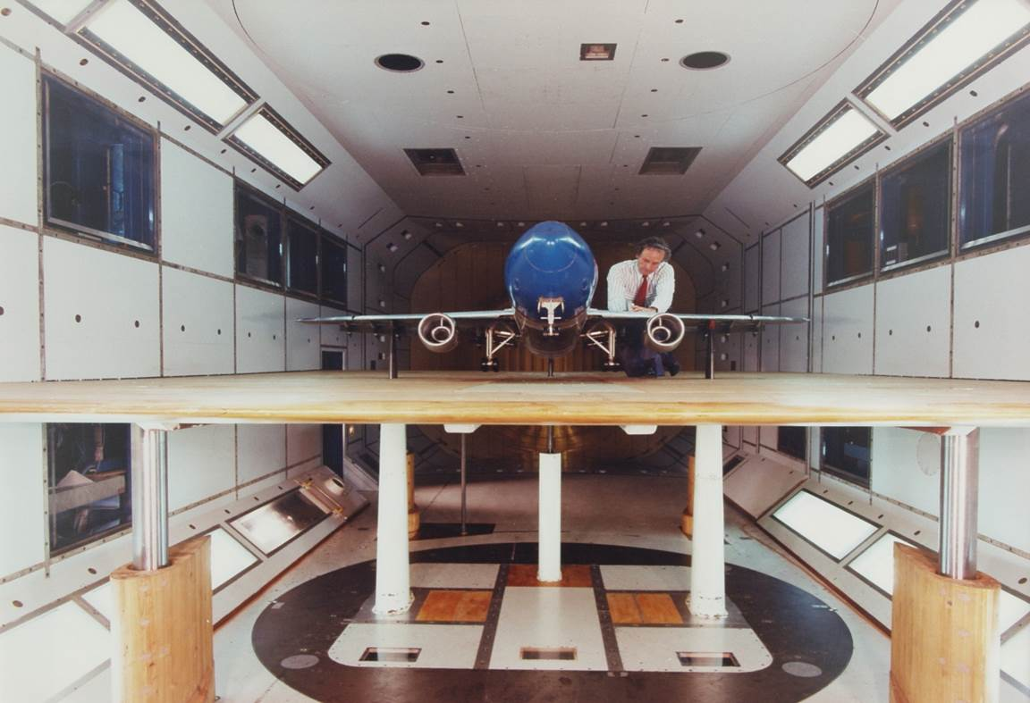
5m Wind Tunnel, Farnborough, Hampshire
Instrumentation
Precision pressure gauges for tunnel control
6-component Loads measurement:
Underfloor weighbeam balance
Several internal strain gauge balances
Underfloor load cell balance (undergoing refurbishment)
Balance Calibration Machine
Model & tunnel walls pressure measurements.
3x TE Measurement Specialties Optimus systems
iMetrum Model Deformation Measurement system (new)
Flow visualisation : minitufts and oil flows
Ground effect testing
Acoustics measurements
PIV (external system providers used)

Slide 3
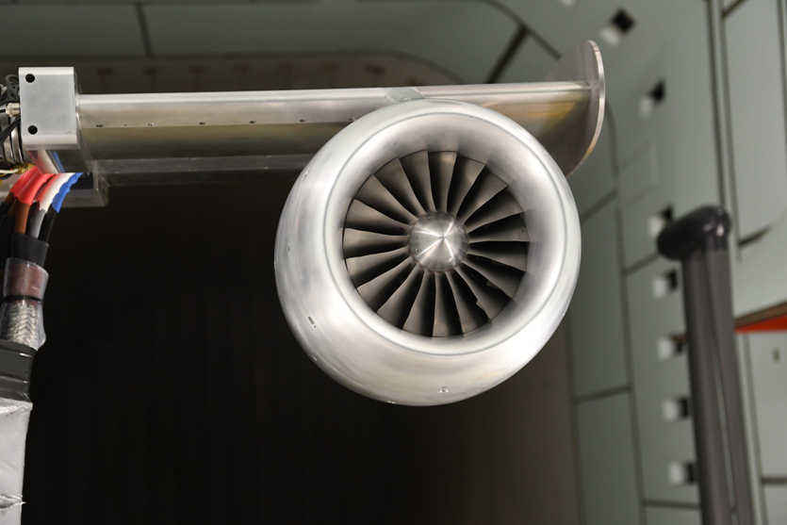
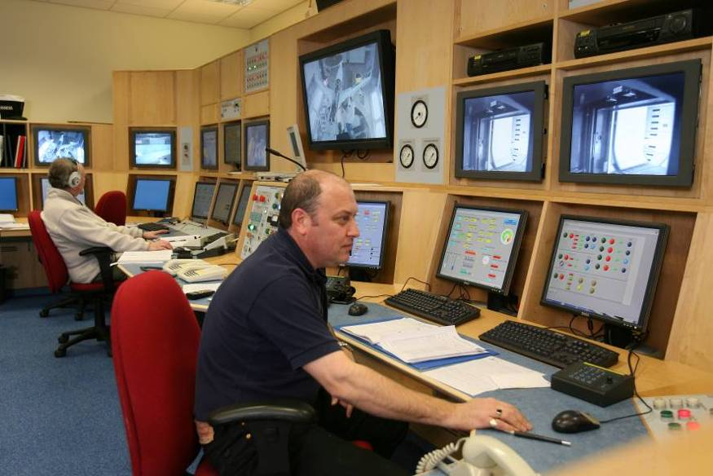
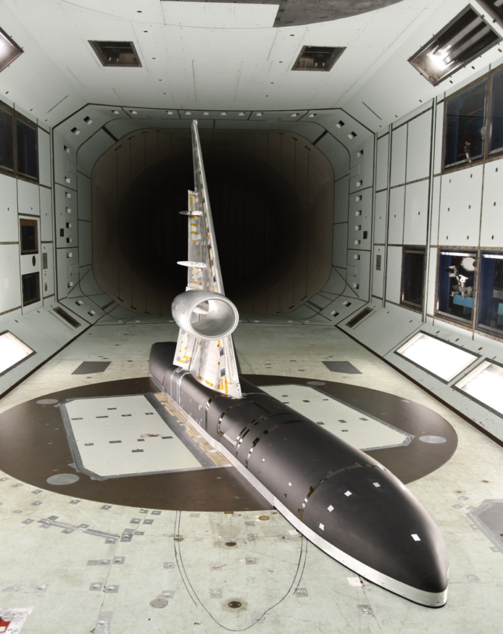
5m Wind Tunnel, Farnborough, Hampshire
Tunnel operations
Test team of ~26 people
Aerodynamics, computing, instrumentation, mechanical & electrical engineers
2 shifts per day operation for most tests (06:00 – 22:30)
Pluses / minuses
First UK test for the global High-Lift Common Research Model initiative in 2019
New 5mWT-sized full-span model will be tested in 2024
Plans to continue expanding facility capability, including further development of electric motor powered aeroengine simulators
Plan to continue forging closer ties within the UK for collaborative working opportunities – dependent upon funding
Ageing workforce and facility will require large investment.

