Slide 1



Slide 2



Presenters
Prof Gary Page
Professor of Computational Aerodynamics
Dr Dhamotharan Veerasamy
Experimental Database coordinator
,
Dr Jason Boldero
Research Associate in Aerodynamics Experimental database development.
Department of Aeronautical and Automotive Engineering,
Loughborough University, United Kingdom

Slide 3
We will be covering…
15.00 Introduction (Gary Page)
15.10 The NWTF Experimental Database (Dhamotharan Veerasamy)
15.35 AeroX aerodynamic data exchange format and demonstration (Gary Page)
16.05 Proposed wind tunnel reference models (Jason Boldero)
16.20 Discussion and closure

Slide 4
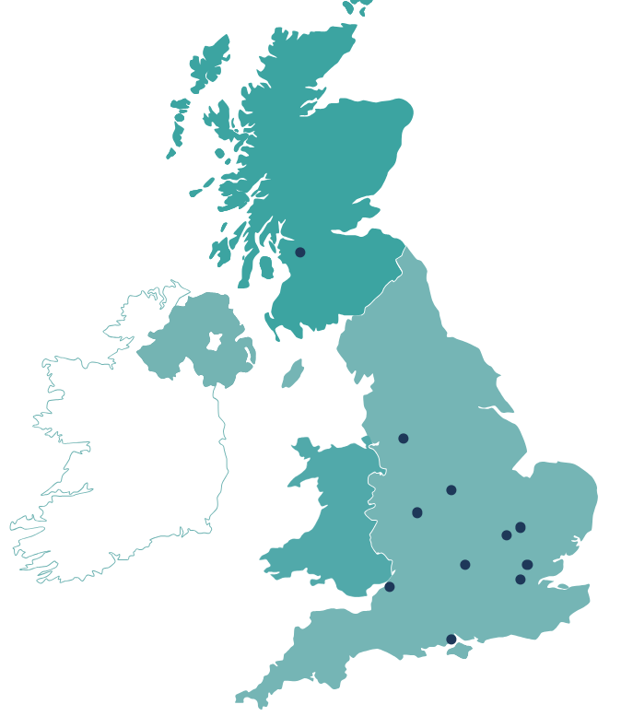












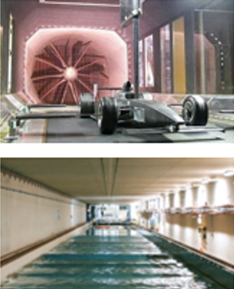

UK, National Wind Tunnel Facilities
Group of 23 strategically important tunnels, across 12 universities
Funded by EPSRC
https://www.nwtf.ac.uk/about/
University of Manchester
Human-Flow Interactions Wind Tunnel,
High Supersonic Tunnel
University of Glasgow
deHavilland Low Speed Wind Tunnel
Loughborough University
Automotive, low speed wind tunnel
University of Cambridge
Transonic and supersonic wind tunnel
Cranfield University
8ft x6ft, Low speed wind tunnel
Icing Tunnel
University of Birmingham
Atmospheric boundary layer tunnel
Train Rig
City, University of London
Low turbulence wind tunnel,
Transonic tunnel
University of Bristol
Aeroacoustic wind tunnel
Boundary layer wind tunnel
Imperial college, London
10Ft x 5Ft, Low speed wind tunnel
Hypersonic Tunnel, Supersonic Tunnel
University of Southampton
RJ Mitchell, Low Speed Wind Tunnel
Anechoic Wind tunnel, Towing Tank
University of Oxford
T6 Piston reflected shock tunnel
Low density tunnel, High density tunnel,
University of Surrey
Environmental flow wind tunnel

Slide 5
The NWTF Experimental Database

Slide 6

Data sharing policy:
F A I R¹ – Findable, Accessible, Interoperable & Reusable
Publicly funded research data should be widely and freely accessible in a timely and responsible manner.
Sufficient metadata must be openly available to enable further research and data reuse, with published results providing access information.
Research integrity should be maintained, avoiding damage from inappropriate data release.
(Most of the funding agencies follow this principle )
What is happening, actually….
Very few publish in the archive repository (or university repository)
- difficult to contact for questions/correction
- Files may not be organised
- minimal data description (Read me file)
¹Wilkinson, M. D., et al., (2016) Scientific data, 3(1), 1-9.

Slide 7
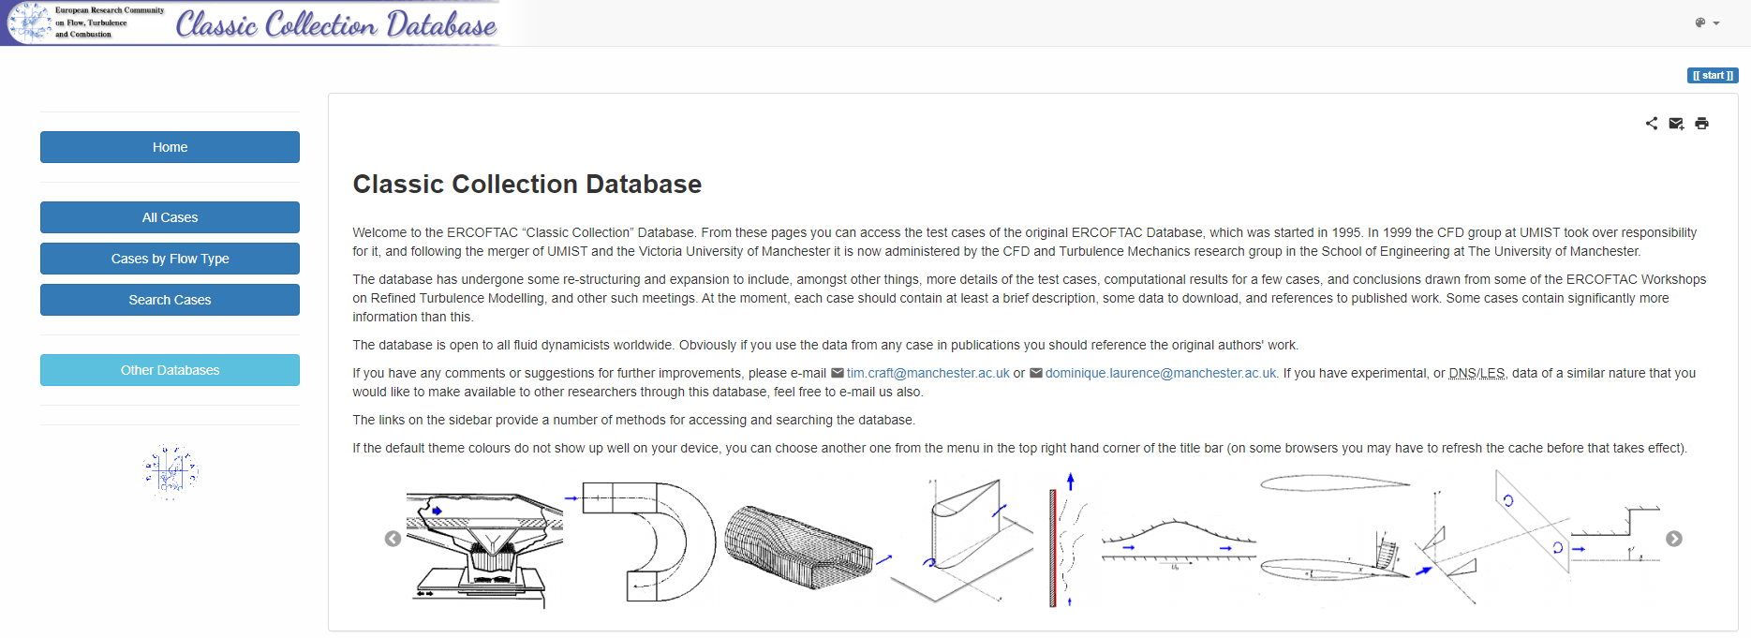
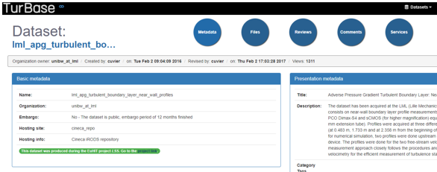
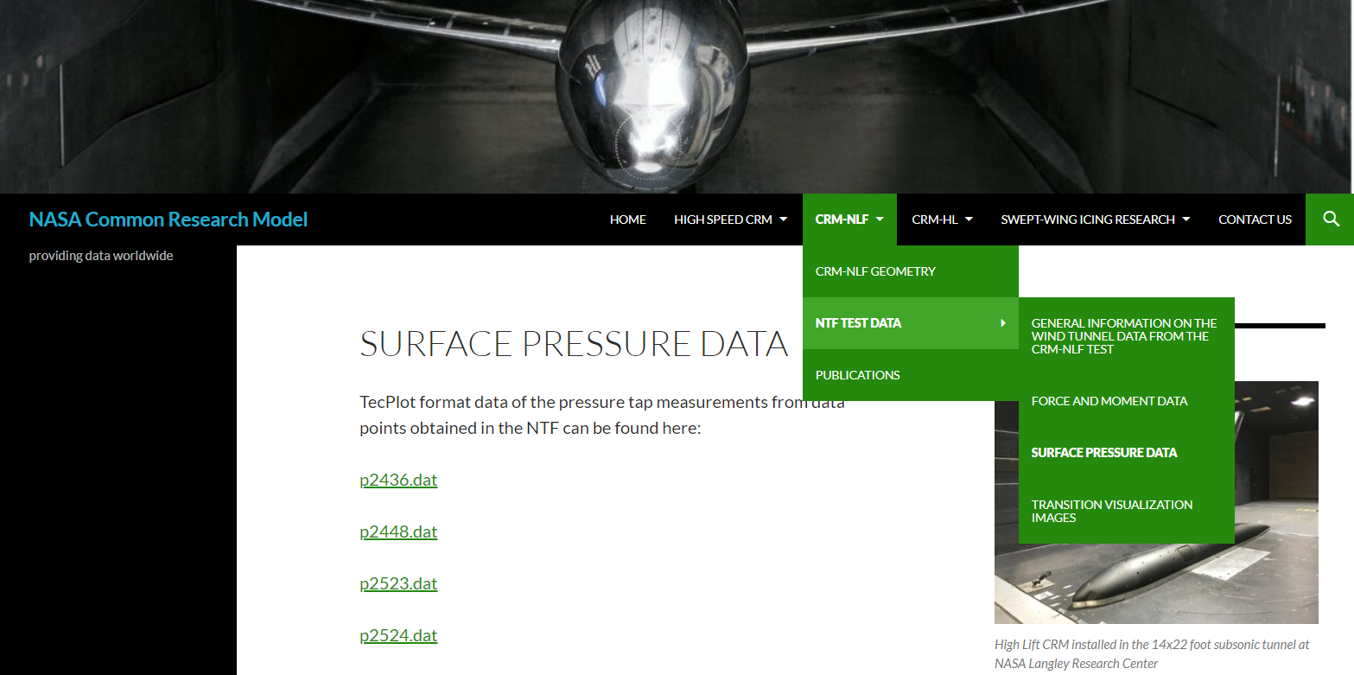
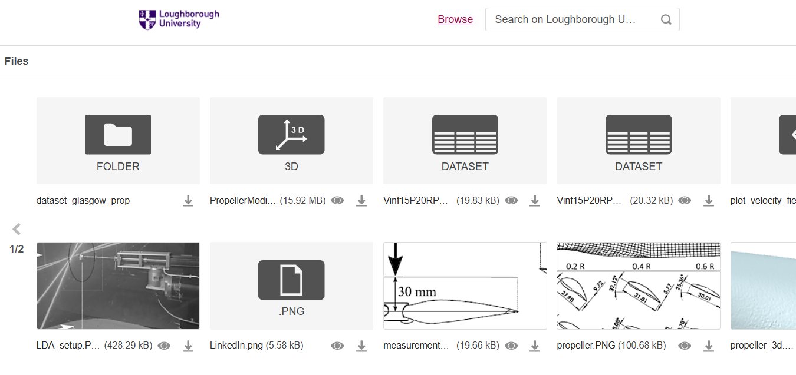
Existing Database & Datasets
ERCOFTAC
Aerodyn
TurBase
NASA
University databases
- Well-designed website for database
- No standard format
- Couldn’t download several cases
- Some of them lack maintenance

Slide 8
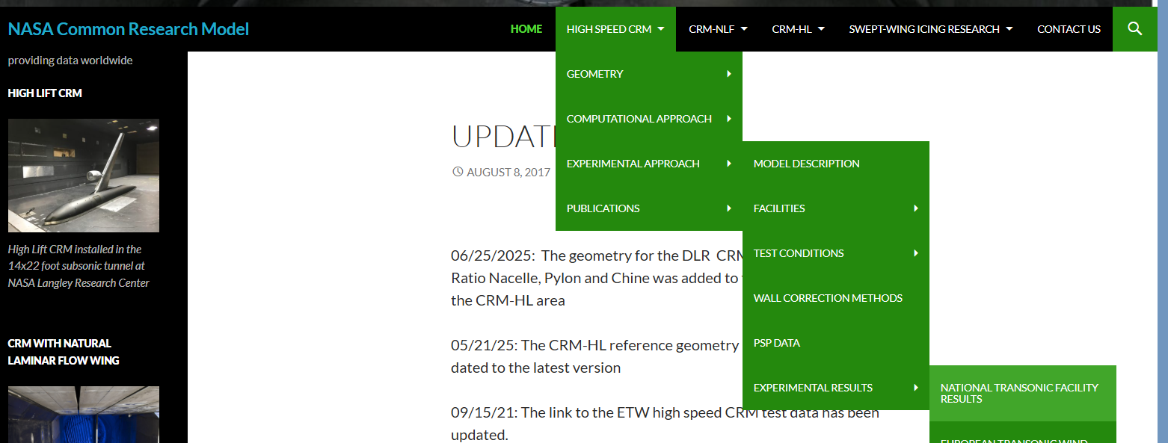
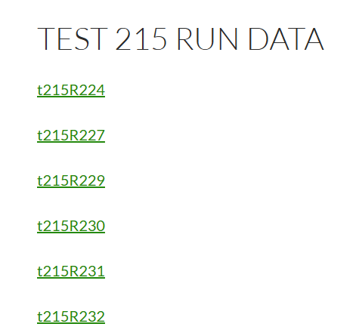
Existing Database & Datasets
This is not to criticise,
It's a very common problem existing in most of the datasets.
Example:
Works well for the expert researchers, not for everyone

Slide 9
Lessons Learned
Inconsistent formats & structure → poor usability
Insufficient metadata → missing experimental context
Limited raw data access (e.g. PIV) → size & policy constraints
Weak documentation → unstructured, fragmented information
Missing CAD / geometry → poor reproducibility & CFD validation
Wind tunnel Datasets are expensive to repeat- should be preserved – for both economical and sustainable reason

Slide 10
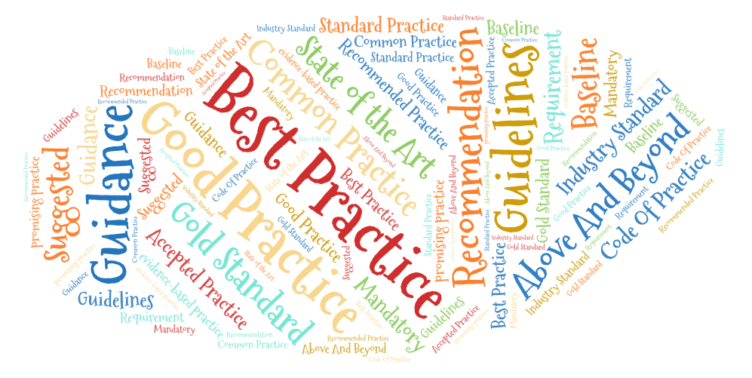
NWTF metadata initiative
Establish guidelines, best practice and standards that can be adopted by others
Aim to be the first-place for aerodynamic datasets- catering to researchers in both UK and International

Slide 11
NWTF Guidelines for metadata
Addresses long-standing issues: fragmented files, inconsistent documentation, poor discoverability
Journal-style structure: campaign overview, facility, conditions, methods
Direct, file-level access: CSV, CAD, processed data (plus full ZIP option)
Reusable assets included: CAD, geometry, coordinate systems, MATLAB scripts
Enhanced traceability: author affiliations + optional LinkedIn links
Human-readable metadata webpages consolidating full experimental context
Consistent metadata template enabling trust, reuse, and future automation

Slide 12
Demo..
NWTF Experimental database
Metadata

Slide 13
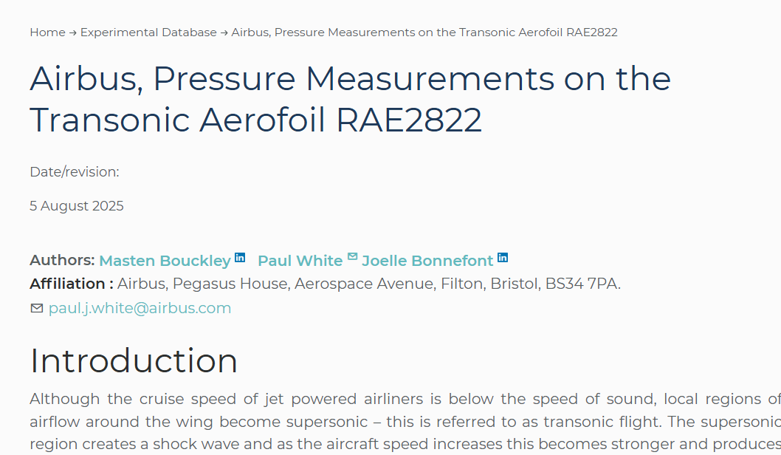
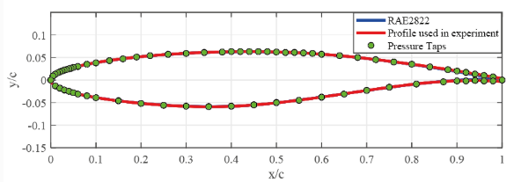
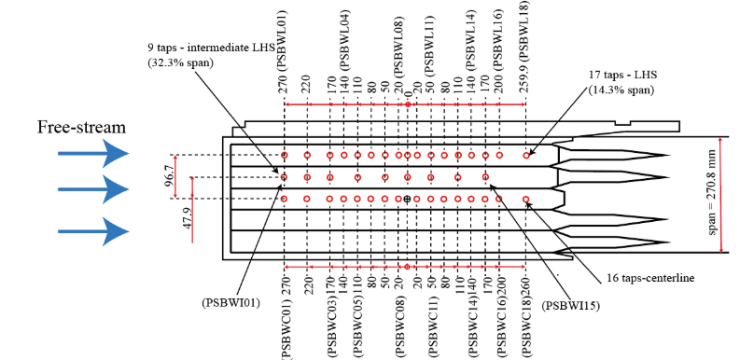
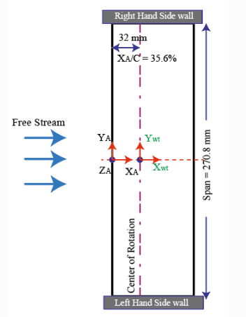
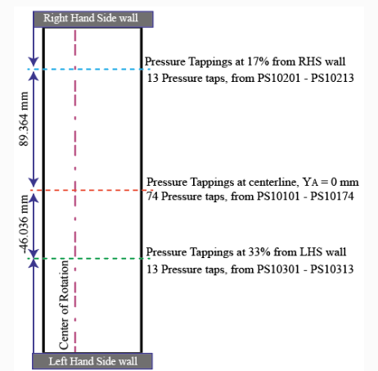
Screen shots of NWTF metadata
Author and contacts
Geometry and measurement locations

Slide 14
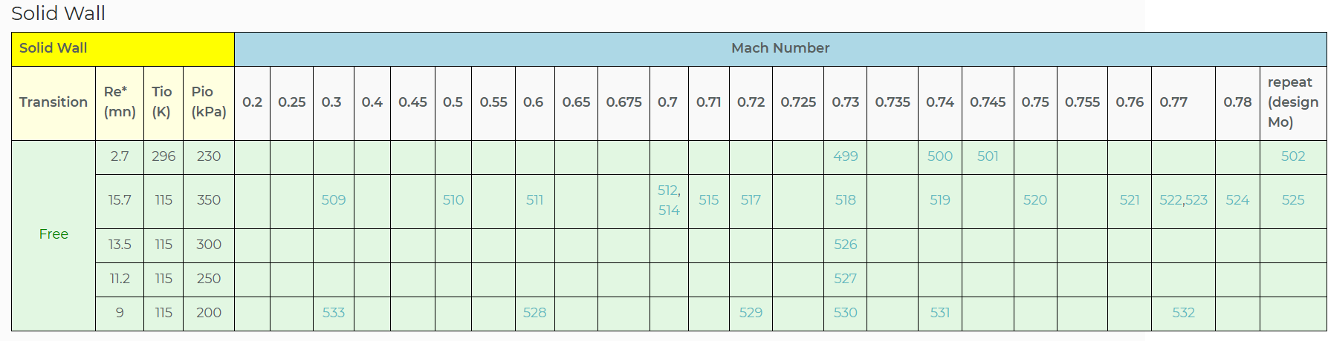
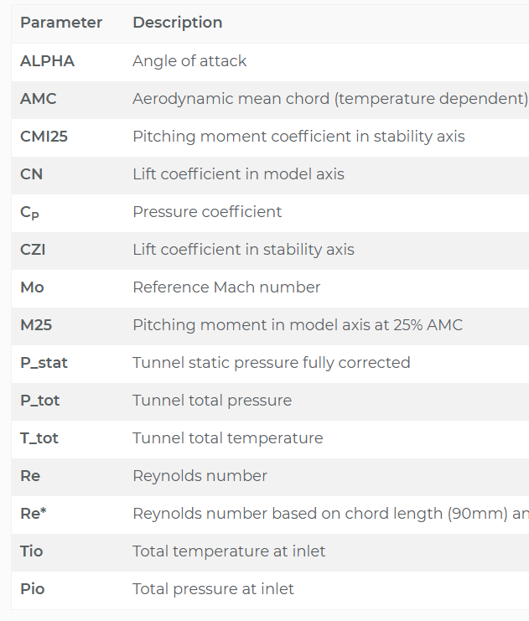
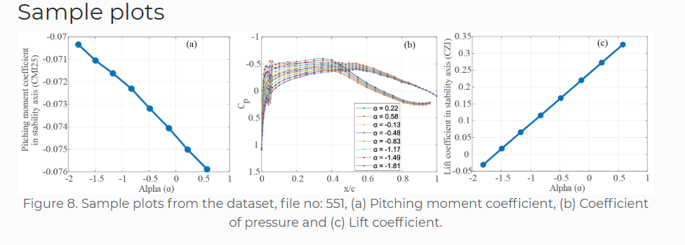
Screen shots of NWTF metadata
Dataset with url
Parameters
Matlab script and Sample plot

Slide 15




What we do..
Data Acquisition
- We collect and gather the relevant experimental data from NWTF tunnels.
Metadata Creation
- Comprehensive metadata documentation in markdown & html
Internal & external Review
- Conduct an internal review process to ensure the quality, and adherence to the standards.
- Corresponding author of the dataset will review the metafile for any corrections.
- Author Acceptance, & publication
Open access & promotion
- Loughborough university host the datasets

Slide 16
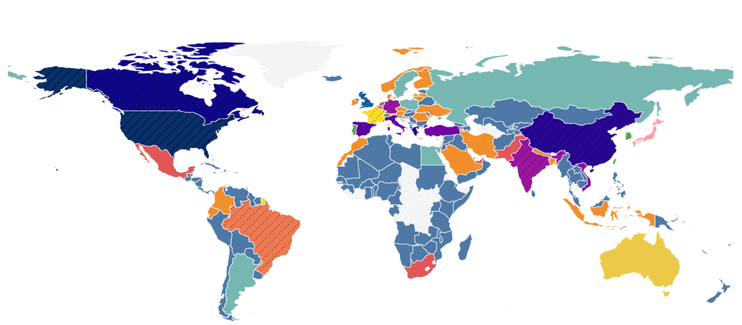
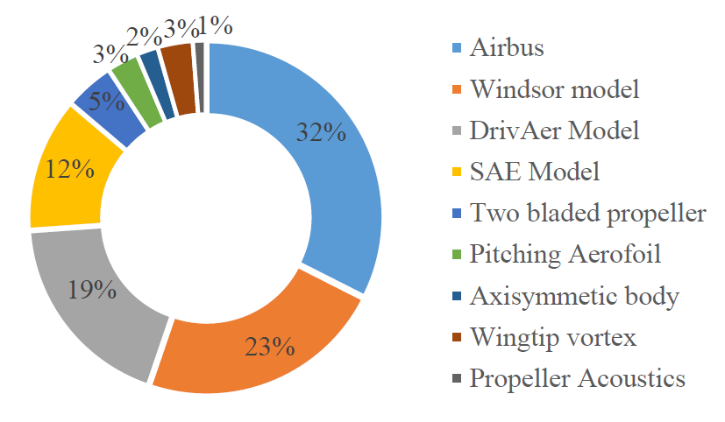
Download statistics
Global distribution of NWTF dataset downloads (Dec 2024–Dec 2025)
User interaction distribution across NWTF datasets, with the Airbus dataset receiving the highest engagement.

Slide 17
AeroX Aerodynamic Data Exchange Format

Slide 18
Lessons learned...
Processed and published many sets of wind tunnel data
Typically columns of data with headers ('Comma Separated Value')
  but often Matlab, Tecplot, Excel .xlsx
The data files are not easily understandable on their own,
  need to refer to README and original journal articles to know meaning and units of variables
  No link in the data file back to the original source
Units were generally SI, but need to be careful of length in mm or m
Needed a reasonably experienced engineer to understand data

Slide 19
Requirements
Be easily readable and understandable by human researchers and AI bots
The format should not depend on the future availability of specific commercial software
Should clearly define the independent variables ('inputs x') and the dependent variables ('outputs y’)
Should contain engineering units
Should be self contained and verbosely descriptive, linking back to source

Slide 20
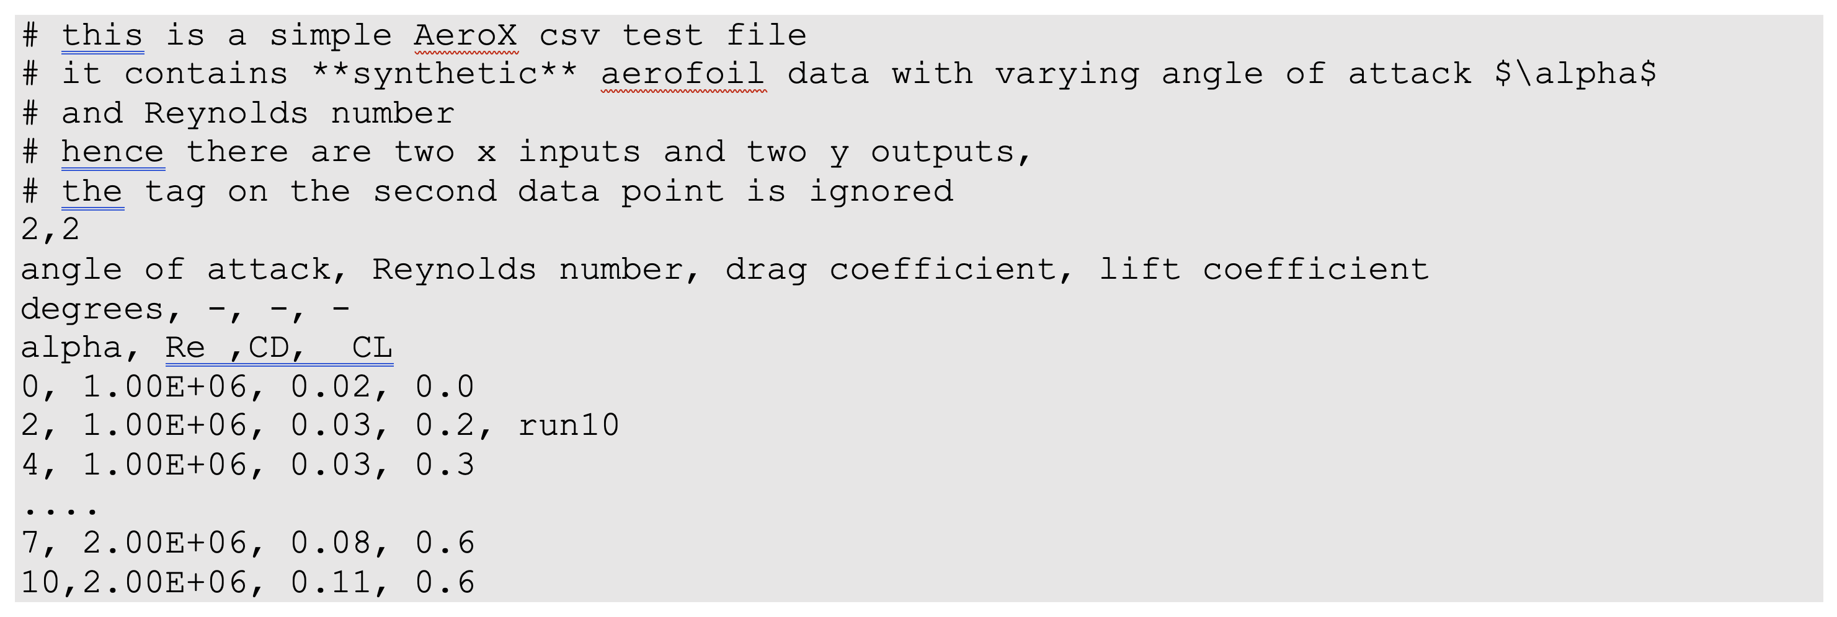
Aerodynamic Exchange file format
Extend a standard CSV with extra comments and headers​
Free text with embedded markdown and latex, defines source of data
Two inputs and two outputs
units
Long variable descriptions
Short variable names
‘simple’ CSV

Slide 21
AeroX Supporting Software
Developed and made freely available a python package to read, write, manipulate and plot AeroX files
  https://github.com/garyjpage/AeroX
We use it to take other formats and process into AeroX standard
Allows users to examine and quickly plot/contour a file that has been downloaded
Can be embedded in other codes to interpolate engineering data

Slide 22
Live Demo

Slide 23
Benefits of AeroX
Simple extension of typical practices
Avoids errors in interpretation
Can provide more traceability of data
Allows researchers to easily and reliably interchange data
  Moving forward all NWTF Experimental Database entries will use AeroX format
Allows AI tools to understand the data
Could be used for any engineering/science data

Slide 24


Benefits of Database
Facilitate Data Reuse :
Enhances efficiency by reusing data for new purposes.
Helps future researchers
Boost Visibility and Citations :
Improves the scientific reputation and visibility of the
- individual researchers
- their lab/team
- institution
Generating more citations.
Support Education : Aids in training new researchers and educating the public.
We encourage all the experimentalist to publish the dataset in a standardised format that can be easily understood by both human and machines.

Slide 25
Wind tunnel reference models

Slide 26
Motivation
Reference Model: A standardised, precisely defined geometry providing a baseline that can be used for correlation and validation studies
Allows validation between experiments and simulations
Comparison across facilities
Removes proprietary information
Enables fundamental understanding

Slide 27
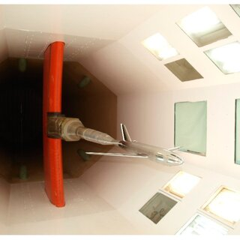
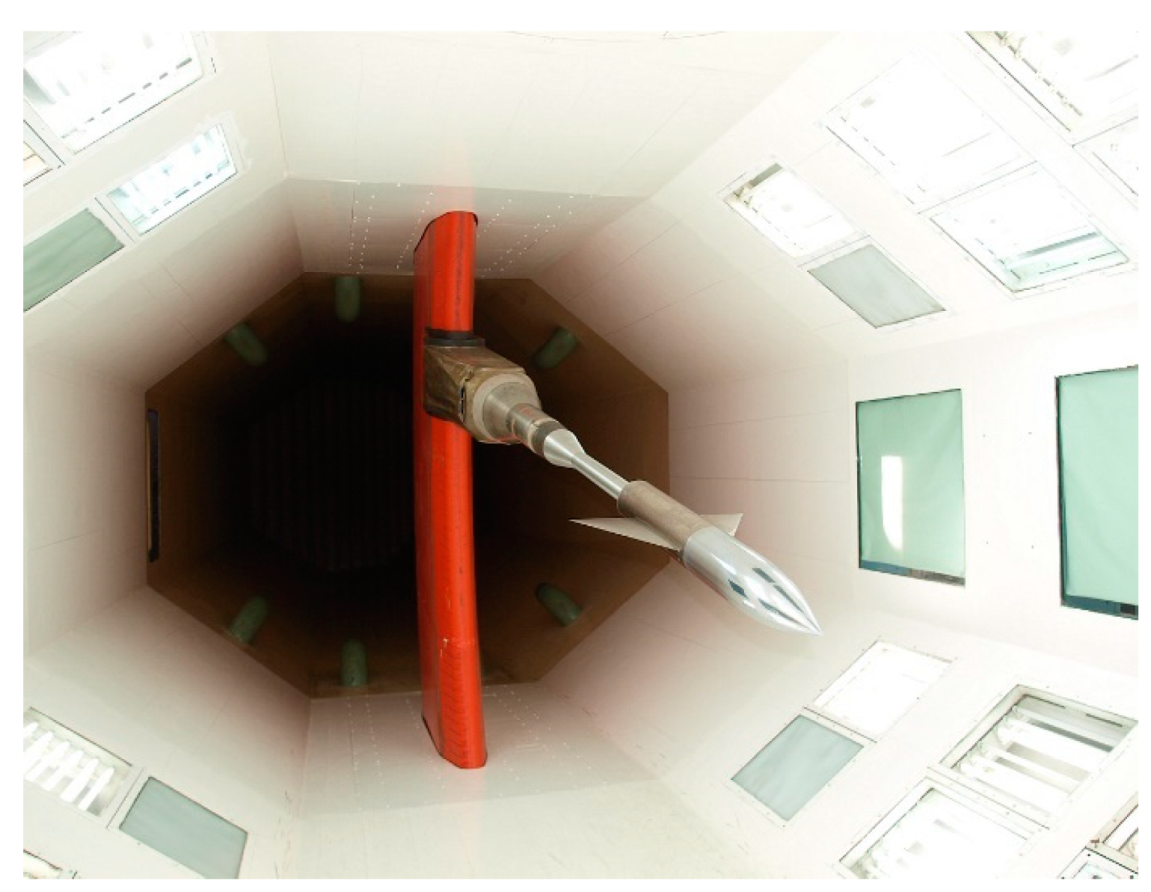
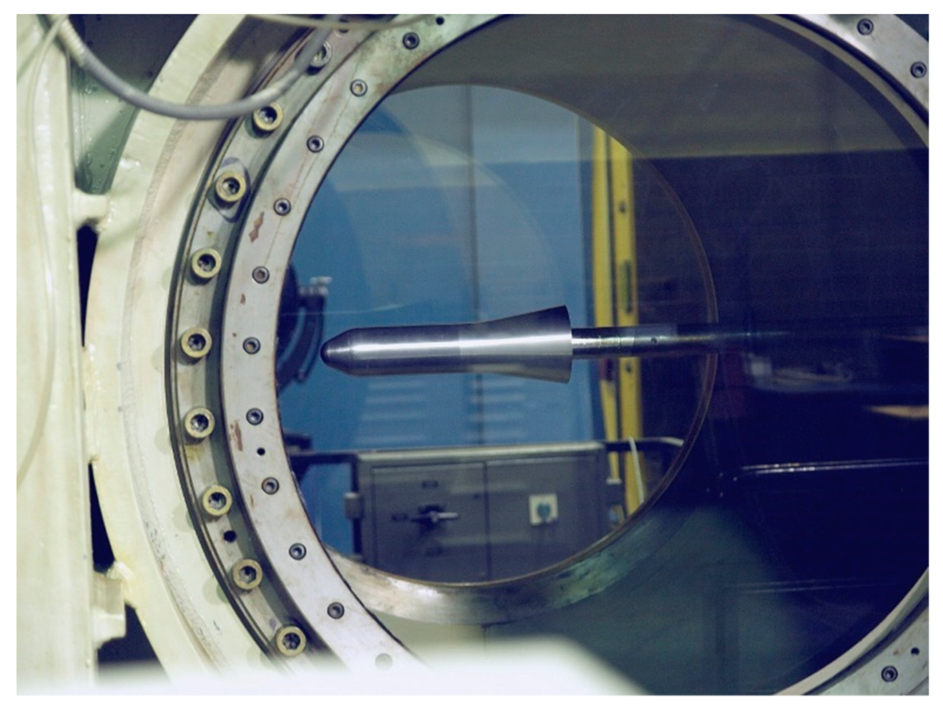
Current Aerospace Models
Low Speed
High Speed
Images from: Damljanović, D., Vuković, Đ., Ocokoljić, G., Ilić, B., Rašuo, B. Wind Tunnel Testing of ONERA-M, AGARD-B and HB-2 Standard Models at Off-Design Conditions. Aerospace 2021, 8, 275. https://doi.org/10.3390/aerospace8100275

Slide 28
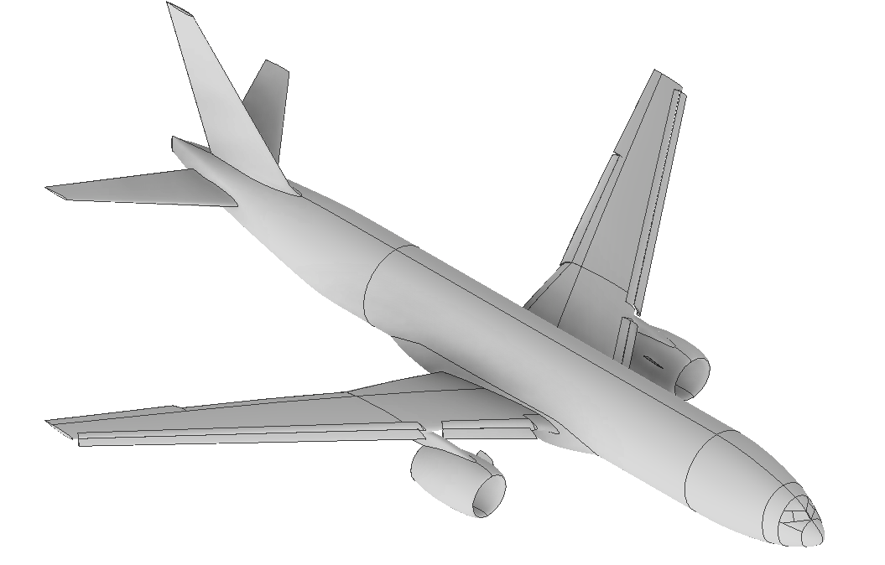
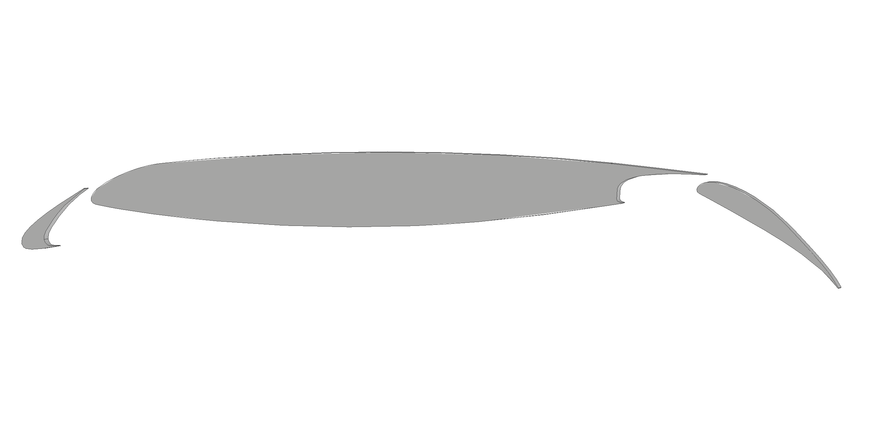
Proposed Aerospace Model
Based on NASA High Lift Common Research Model
Constant Chord
Swept Design
Measure in centre plane to avoid 3-dimensional effect
Development to begin 2027

Slide 29
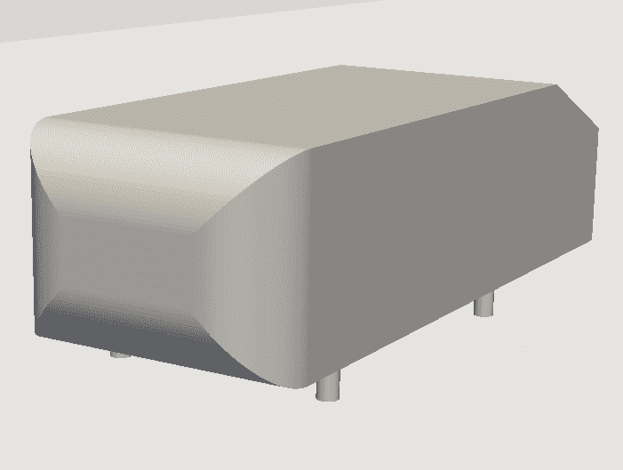
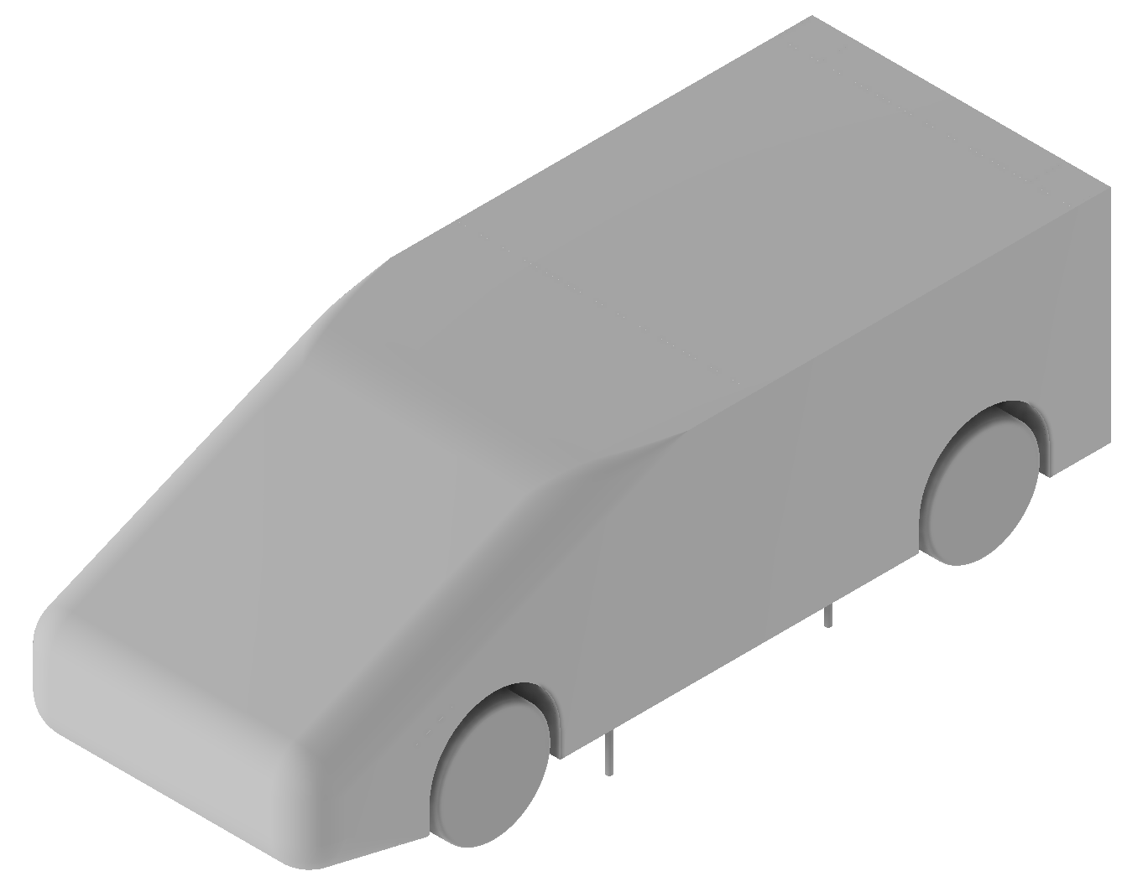
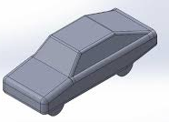
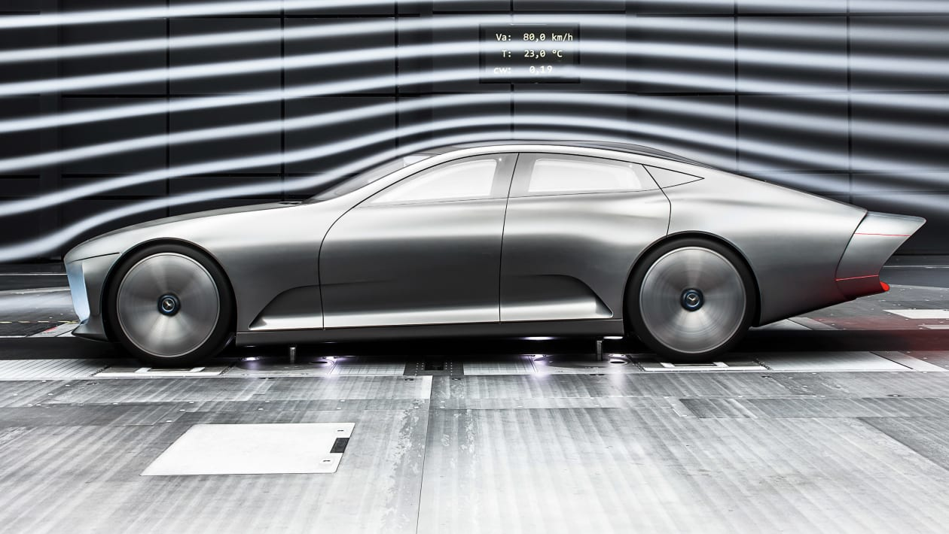
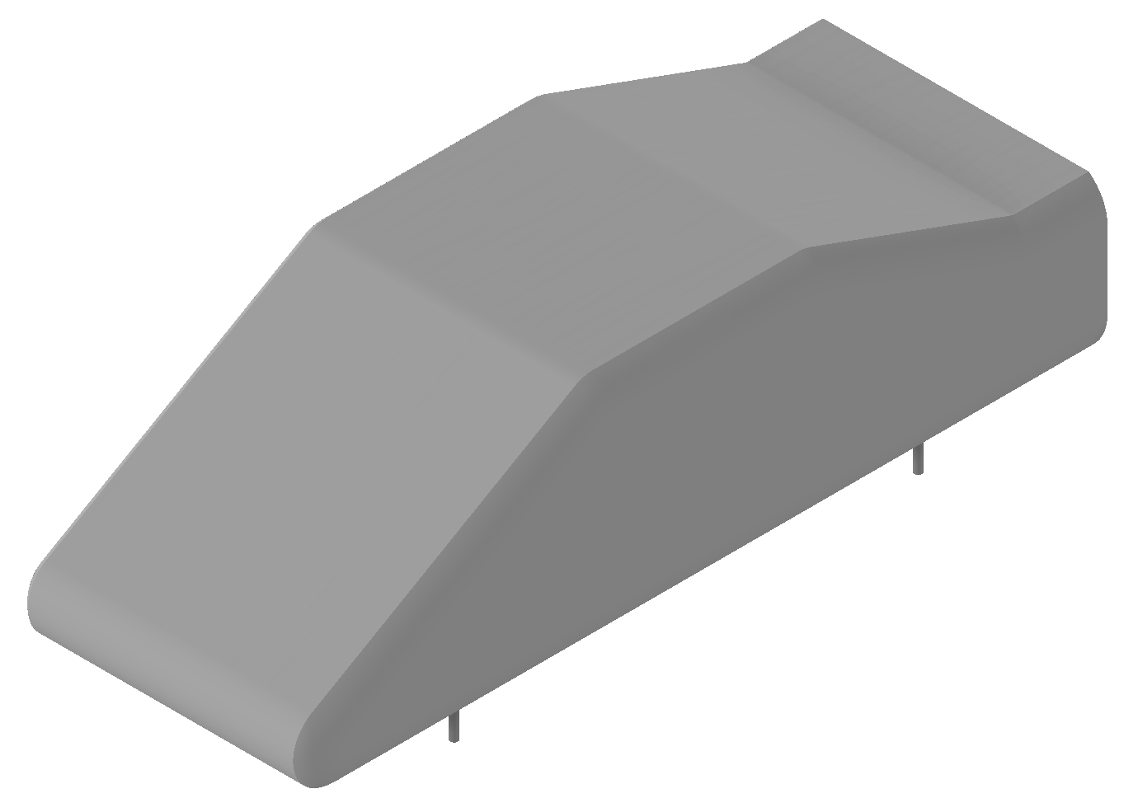
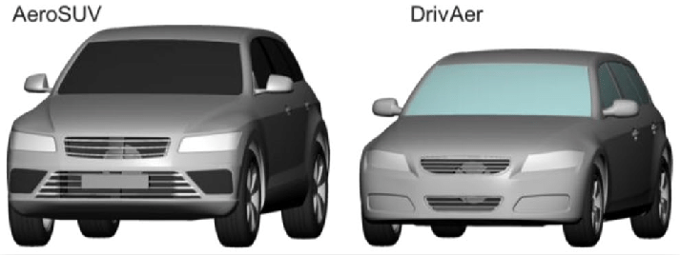
Automotive Models
Simplistic
Advanced
New Model

Slide 30
Model Assumptions
Symmetrical
‘Slick’ tyres
No detailed features:
  Door handles
  Wing mirrors
  Glass imprints
  Wheel rim details
  Through flow
  Panel gaps

Slide 31
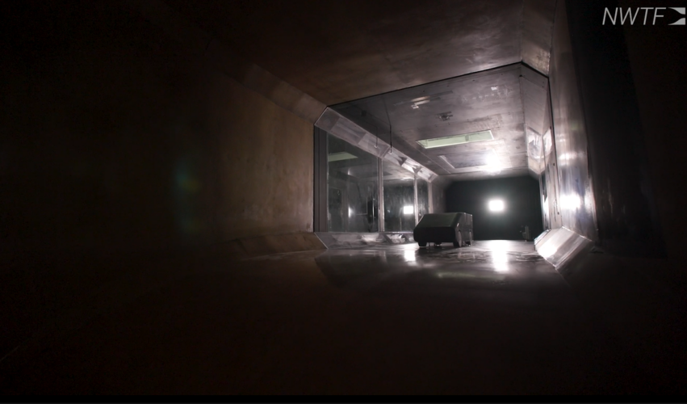
Testing Plan
Start in Loughborough Automotive Tunnel
Plan to test the same model across the NWTF

Slide 32
New Model and AI
Fully Parameterised
Conduct specific studies involving geometry
Train Predictive Model AI
Reduce computation/experimental costs

Slide 33
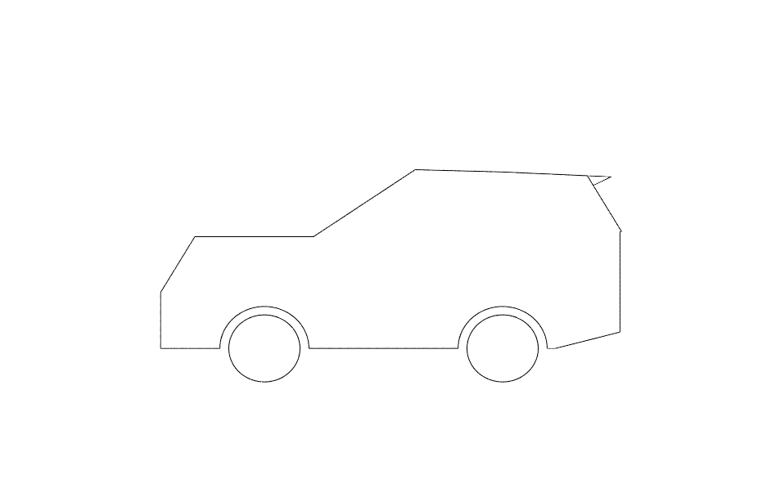

Current Base Model

Slide 34
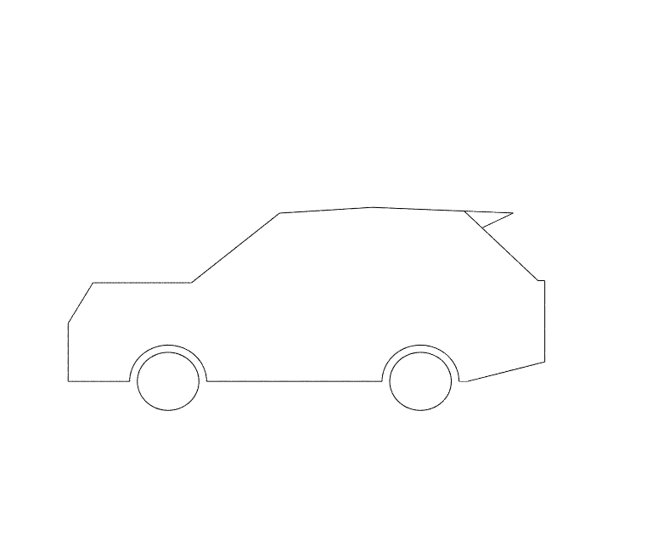
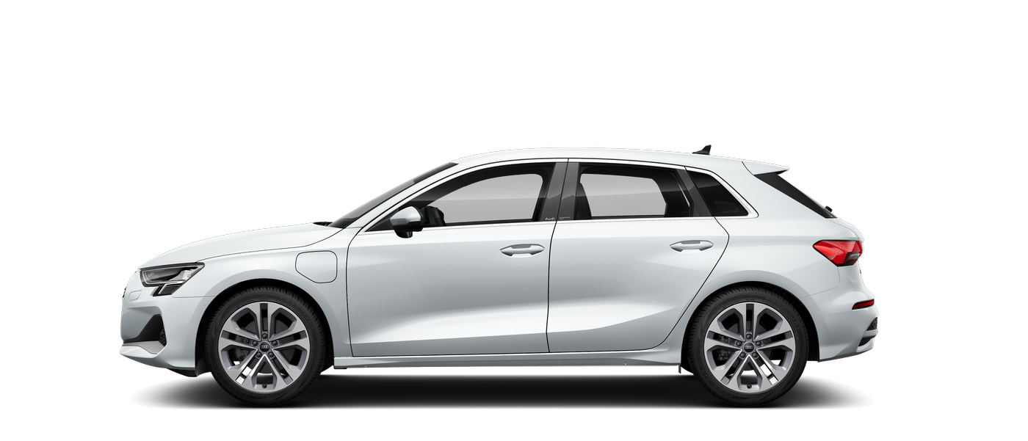
Current Development

Slide 35
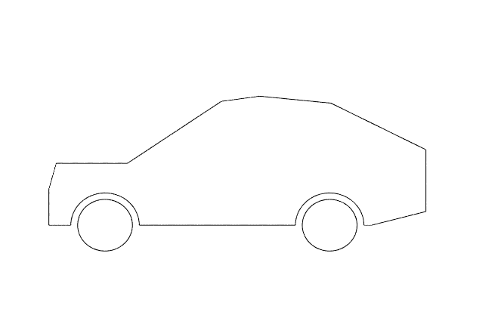
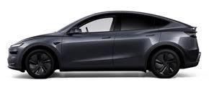
Current Development

Slide 36
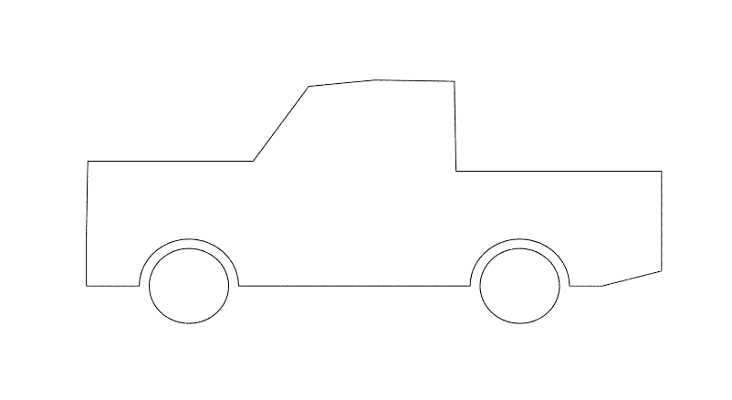
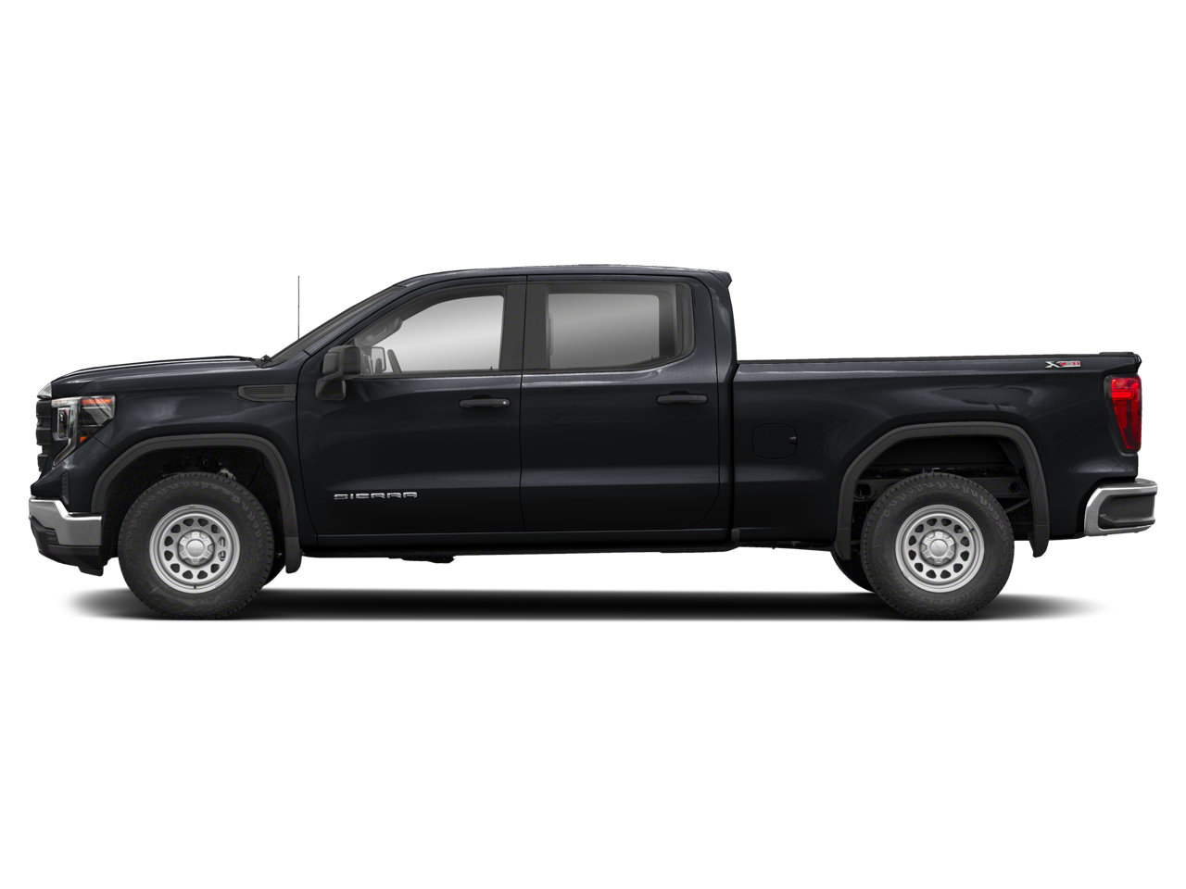
Current Development

Slide 37
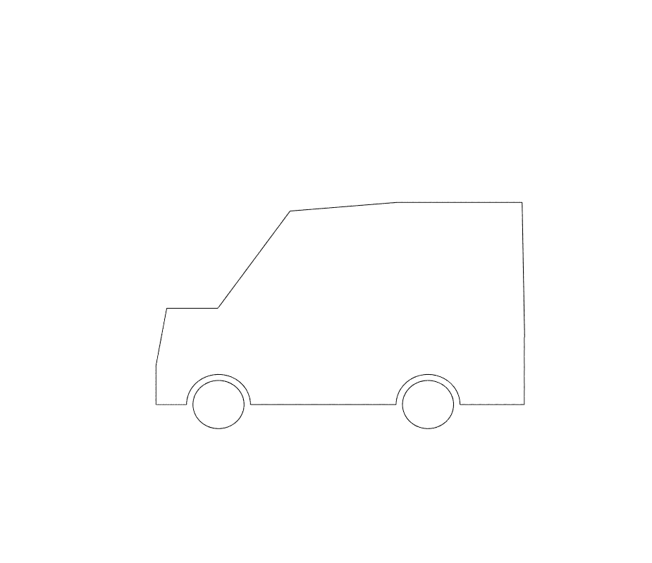
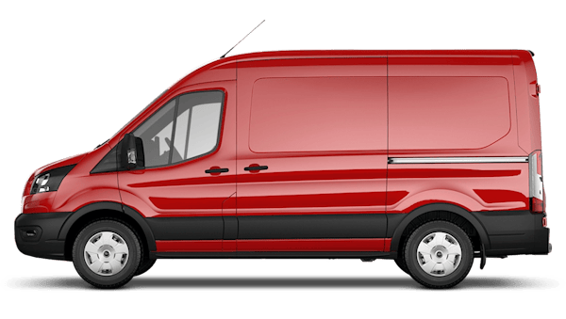
Current Development

Slide 38
Conclusions
Current aerospace models cover wide range of flight conditions
Proposal for new swept wing model
Automotive models either too simplistic for industry or too complex for academia
Proposal for new, parameterised automotive model
  Can be used to train AI
  Primary use for academia and initial industry designs
  Initial testing shows versatility

Slide 39
Next Steps
Automotive Model
  Finalise 2D geometry creation
  Extend to 3D
  Full parameterisation
  Creation of base model
  Wind Tunnel Testing
Aerospace Model Development in 2027

Slide 40

Contact
Thank you
admin@nwtf.ac.uk

